Slide 1


Design characteristics and verification of Chambers for testing to
CISPR 25 and ISO 11452-2
Presented by: Louis A. Feudi raymondemc.ca

Slide 2

Scope
CISPR 25 Scope
Key Definitions
Qualification of ALSE Absorber
Design Characteristics of Chamber
Chamber Verification methods
  Reference measurement Method
  Long Wire measurement Method
Influence Parameters affecting Chamber performance

Slide 3
CISPR and IEC
Comité International Spécial des Perturbations Radioélectriques (English translation: International Special Committee on Radio Interference)
Part of the International Electrotechnical Commission (IEC)
CISPR drafts standards for controlling electromagnetic interference
For Electrical and electronic devices

Slide 4
CISPR and IEC
Two types of standards
Guideline standards – provided for use by a product standard committee as a “basic framework”
Product Specific Standards – Tailored to evaluate and verify that a specific product or product category is compliant with a specific set of requirements that can be impacted by environment, user interface, and safety requirements where applicable.

Slide 5
CISPR 25
Standard for “Vehicles, Boats, and Internal Combustion Engines-Limits and Methods of Measurement for the Protection of On-Board Receivers”
On-Board Receivers include
    Sound and Television Broadcast Receivers
    Land mobile Radio
    Radio Telephone
    Amateur, Citizens Radio
    Satellite Navigation (GPS)
    WiFi, Bluetooth
    Both connected to vehicle harness and after market add-ons to on board power connector

Slide 6
CISPR 25 Edition 4: 2016
Corrigendum 1:2017
Most recent publication
Provides Test Procedures and Emission Limits for both entire Vehicle electrical system on-board components (Clause 5) and modules independent from the vehicle (Clause 6) from 150 kHz-2500 MHz
“Sets limits for electromagnetic emissions from components to prevent objectionable disturbance to on-board receivers.” Protects receivers in the vehicle from components/modules in same vehicle
Does not cover protection from RF Emissions and pulse-type voltage fluctuations (ISO)
Limits recommended and subject to modification by vehicle manufacturer

Slide 7
CISPR 25 Edition 4: 2016
Corrigendum 1:2017
Chamber Definitions
  Shielded Enclosure – Mesh or Sheet Metal Housing electromagnetically separating internal and external environment
  ALSE – Absorber Lined Shielded Enclosure
  Bonded – DC resistance less than 2.5 milli-ohms
  Reference Ground Plane – flat conductive surface whose potential is used as a common reference
  Validation Ground Plane – elevated reference ground plane with the dimensions of 2.5m by 1m used as standard for reference measurements and modelling per Annex J.

Slide 8
Shielded Enclosure
Provides an environment with ambient electronic noise (a minimum of) 6dB below emissions limits specified
Most standard shielded enclosures provide the following Shielding effectiveness:
  Magnetic: 55dB @ 10kHz; 95dB @ 200kHz; 100 dB @ 1 MHz
  Electric: 100dB from 15kHz to 100MHz
  Planewave: 100dB from 100MHz to 1GHz
  Microwave: 100dB at 10GHz, 100dB at 18GHz

Slide 9
Important Components of Shielded Enclosures
Constructed of steel, with a
  Minimum single leaf door,
  Honeycombed vents
  Electrical power filters
  Pipe penetrations
  Bulkhead panels w/connectors
  Lighting
Eliminates or drastically reduces ambient emissions

Slide 10
Absorber Lined Shielded Enclosure (ALSE)
With steel walls, reflected energy can cause measurement errors of as much as 20dB
So absorber material lined on walls and ceiling
No absorber on floor for Vehicle Tests
Ferrite tile up to 25mm thick can be added to floor for component testing if the ALSE performance in this configuration meets the requirements of Annex J of CISPR 25
Minimum size determined by ensuring 1m separation of both vehicle/EUT and antenna from the nearest surface of absorber material

Slide 11
ALSE
“For Radiated Emissions measurement…, ALSE shall be cleared of all items not pertinent to the test (removes reflection sources like unnecessary equipment, cable racks, storage cabinets, desks, chairs, etc.)”
Absorber material performance shall be greater than or equal to 6dB from 70 MHz to 2500 MHz
Additionally, the chamber performance is confirmed using the validation procedure described in Annex J.

Slide 12
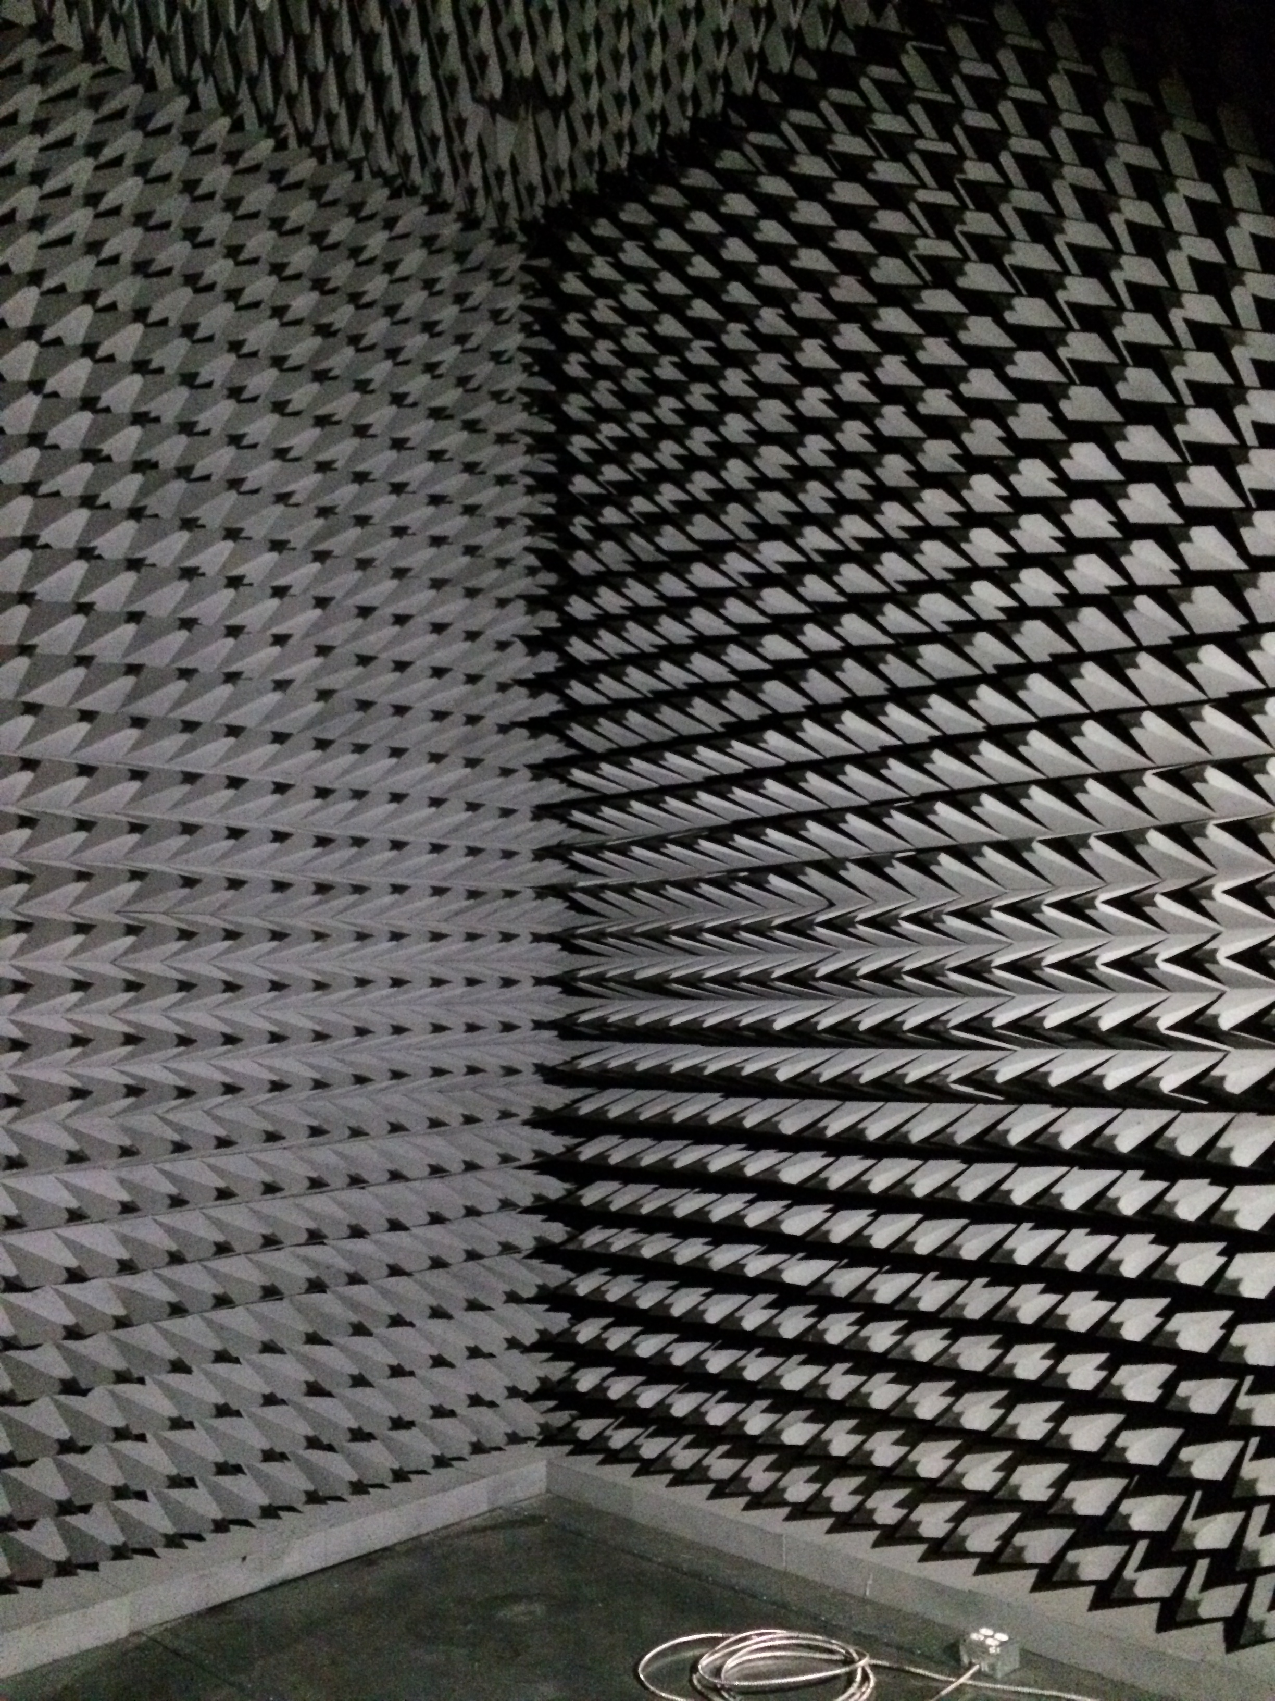
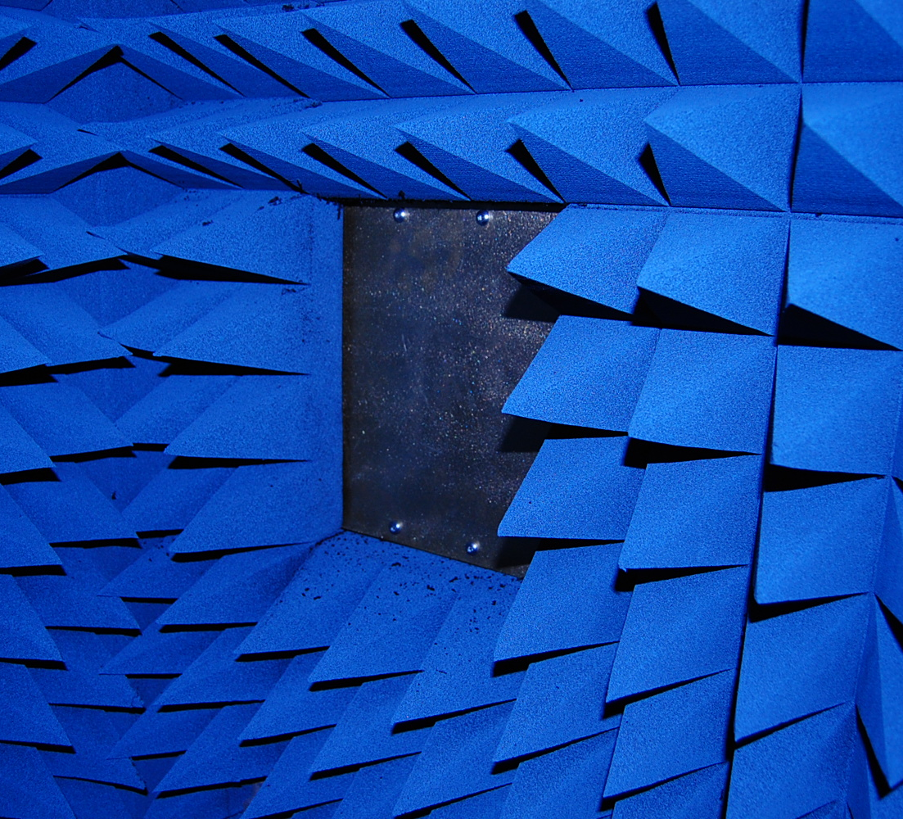
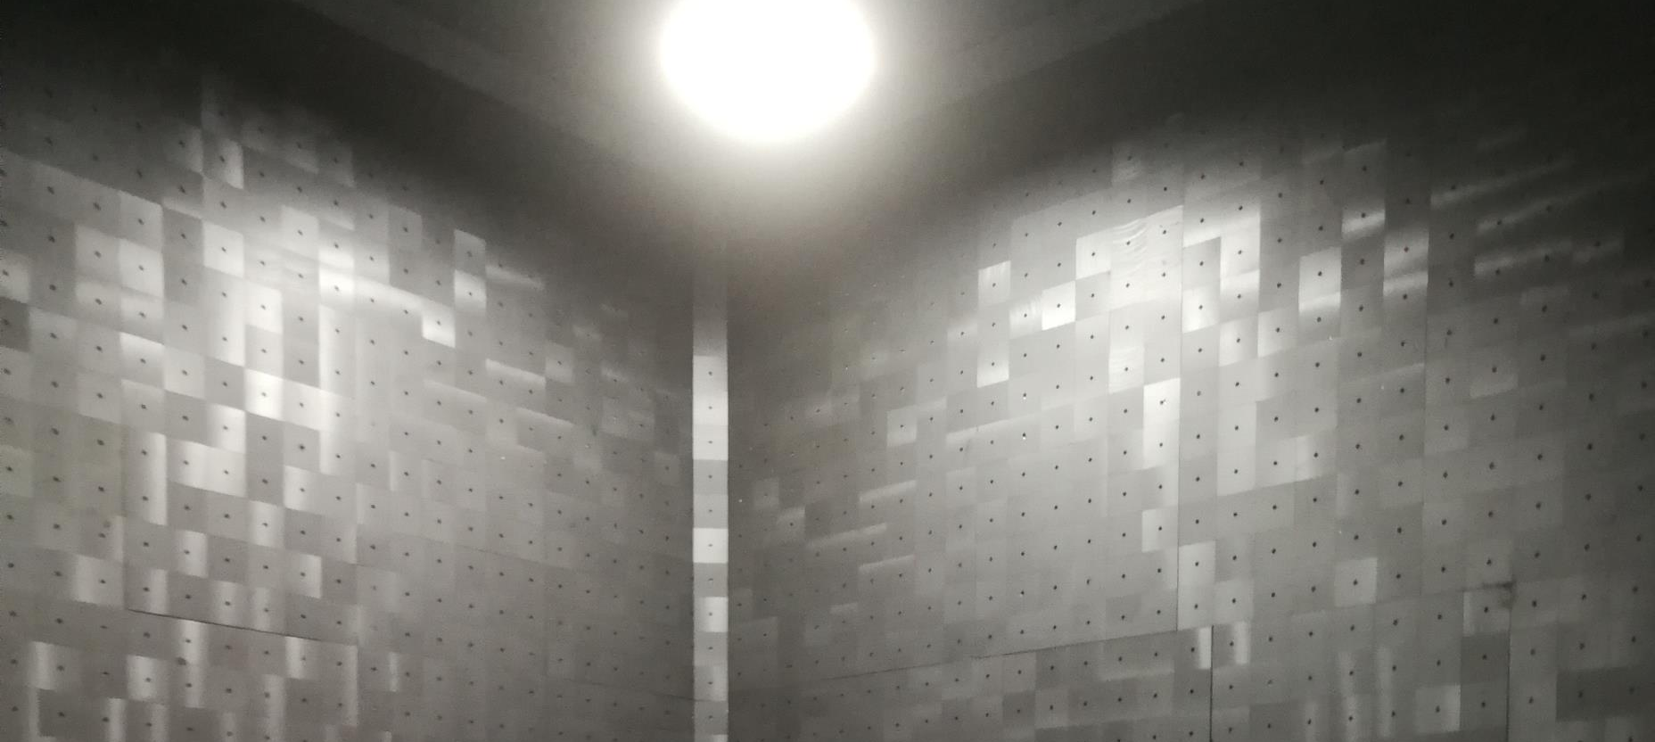
Ferrite and Absorber

Slide 13
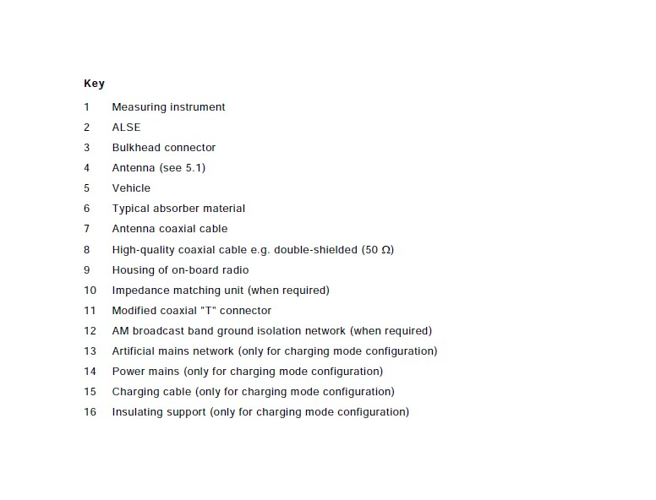
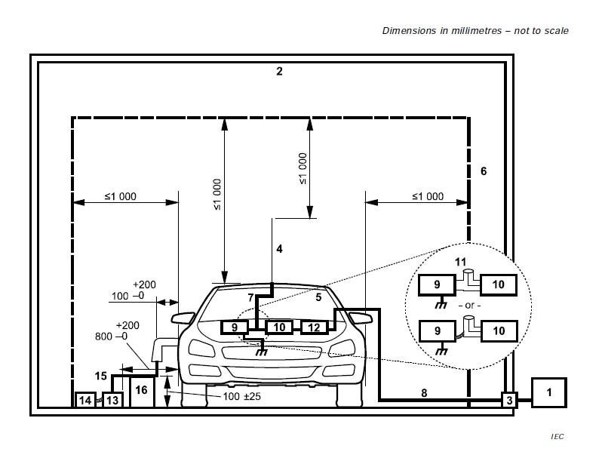
Vehicle Chamber: Spacing/Setup

Slide 14
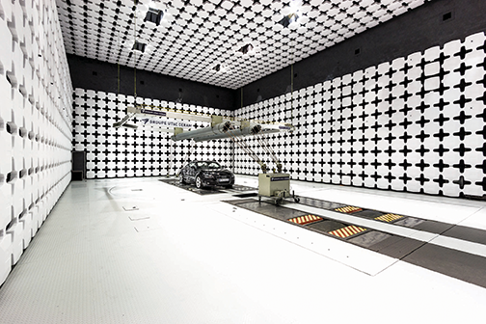
Courtesy of ETS Lindgren

Slide 15
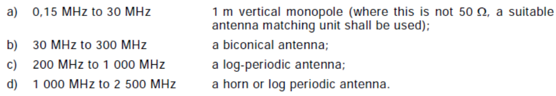


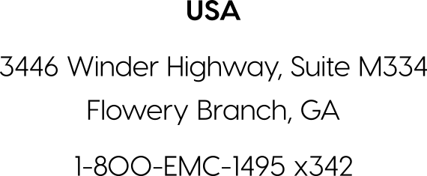
Antenna Systems (50 Ω)

Slide 16
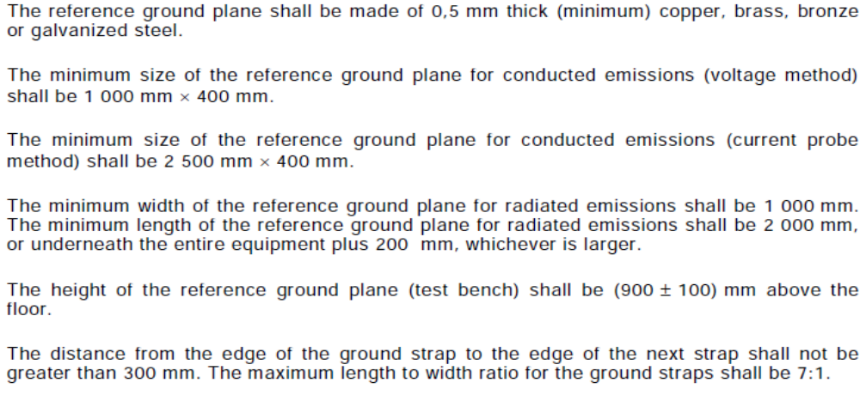
Test Table

Slide 17
EUT/Table Setup
Bonding to Chamber ground < 2.5mΩ
EUT placed on non conductive, low relative permittivity material at (50 +5) mm above reference ground plane (RGP)
EUT not grounded to reference plane unless intended to simulate actual vehicle configuration
Side of EUT located a distance of (200+10) mm from front edge of RGP
Test Harness between EUT and load simulator, including power lines, shall not exceed 2 m
Test Harness placed on non conductive, low relative permittivity material at (50 +5) mm above RGP

Slide 18
EUT/Table Setup
Length of test harness parallel to front of RGP shall be 1.5m (+ 75mm)
Long segment of harness parallel to front edge of RGP located (100+10) mm
Measurement taken at 1m distance from long segment of Test Harness
Phase Center of Antenna located in line with center of longitudinal part of Test Harness (up to 1GHz) and with EUT (above 1GHz)
Monopole counterpoise bonded to RGP
Antennas (excluding rod antenna) calibrated at 1m measuring distance

Slide 19
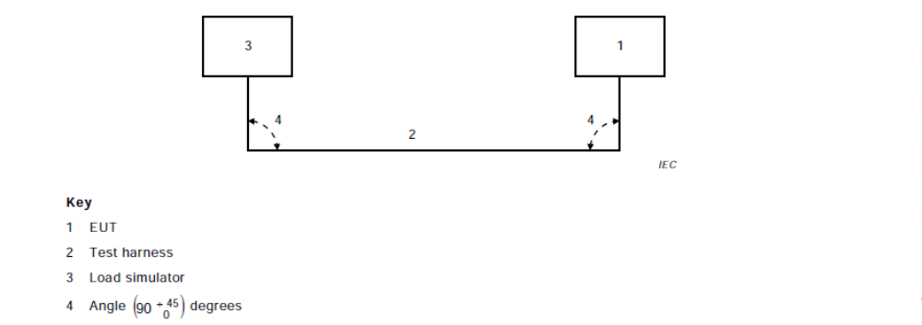
EUT/Table Setup

Slide 20
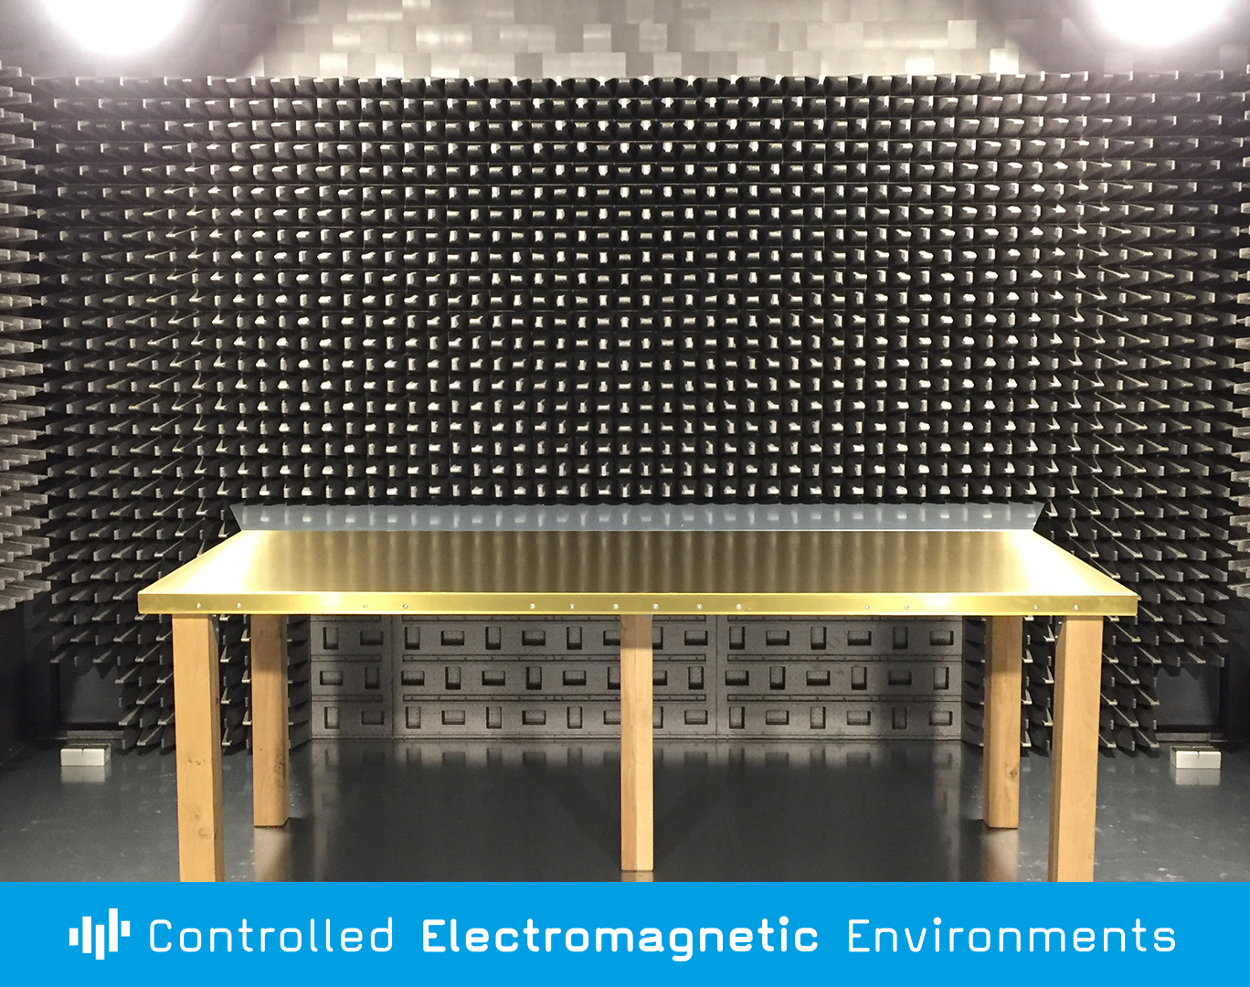
Component Chamber/Validation
Ground Plane Test Table Setup
Picture shows quick release setup for table bonding resulting in DC resistance < 2.5 mΩ

Slide 21
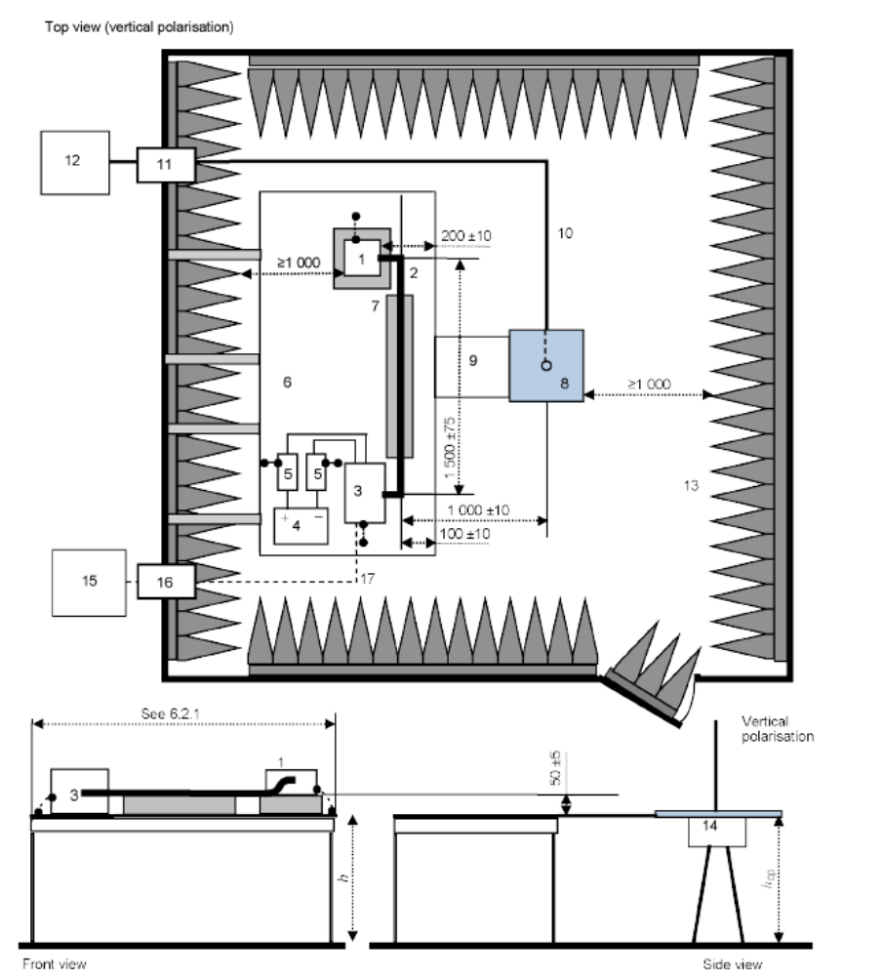
Rod Antenna Setup
150 kHz to 30 MHz vertical polarization only

Slide 22
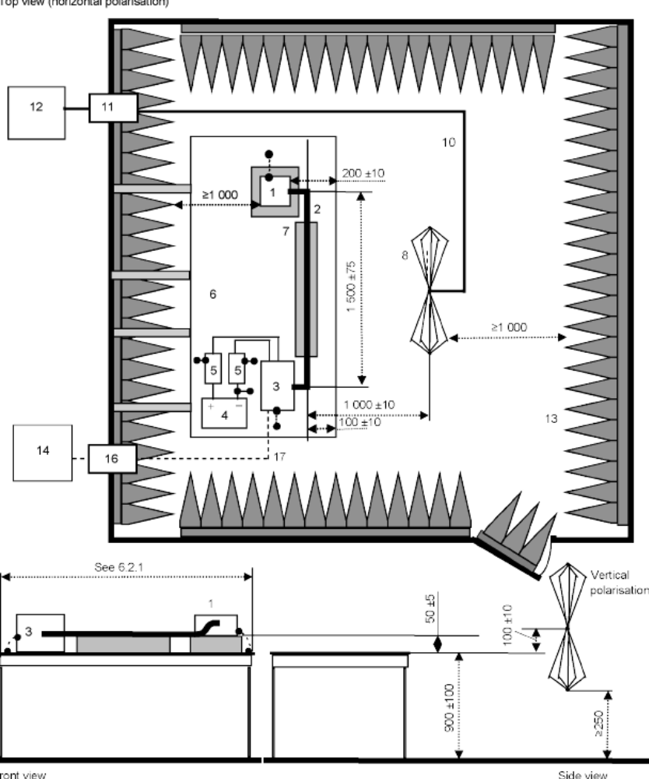
Biconical Antenna Setup
Horizontal and Vertical Polarization

Slide 23
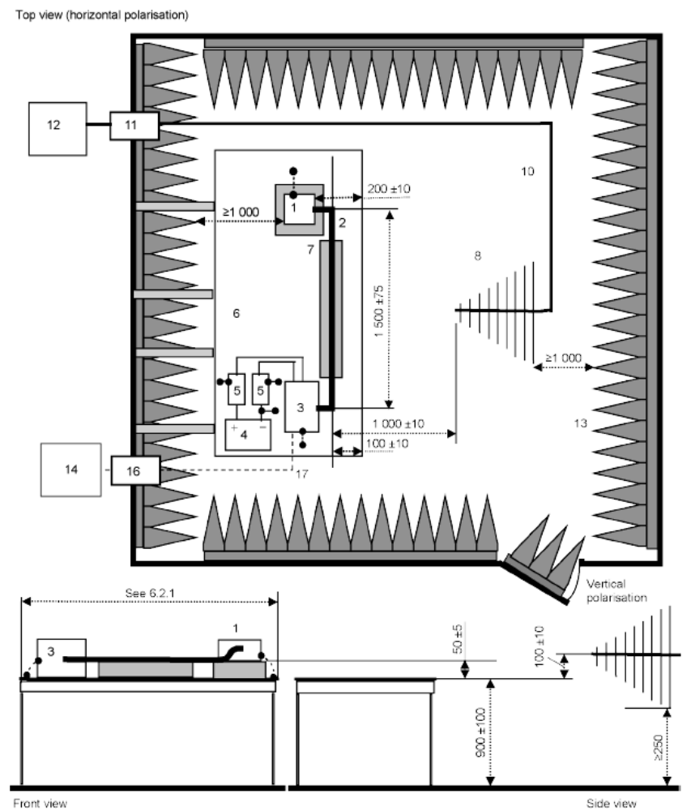
Log Periodic Antenna Setup
Horizontal and Vertical Polarization

Slide 24
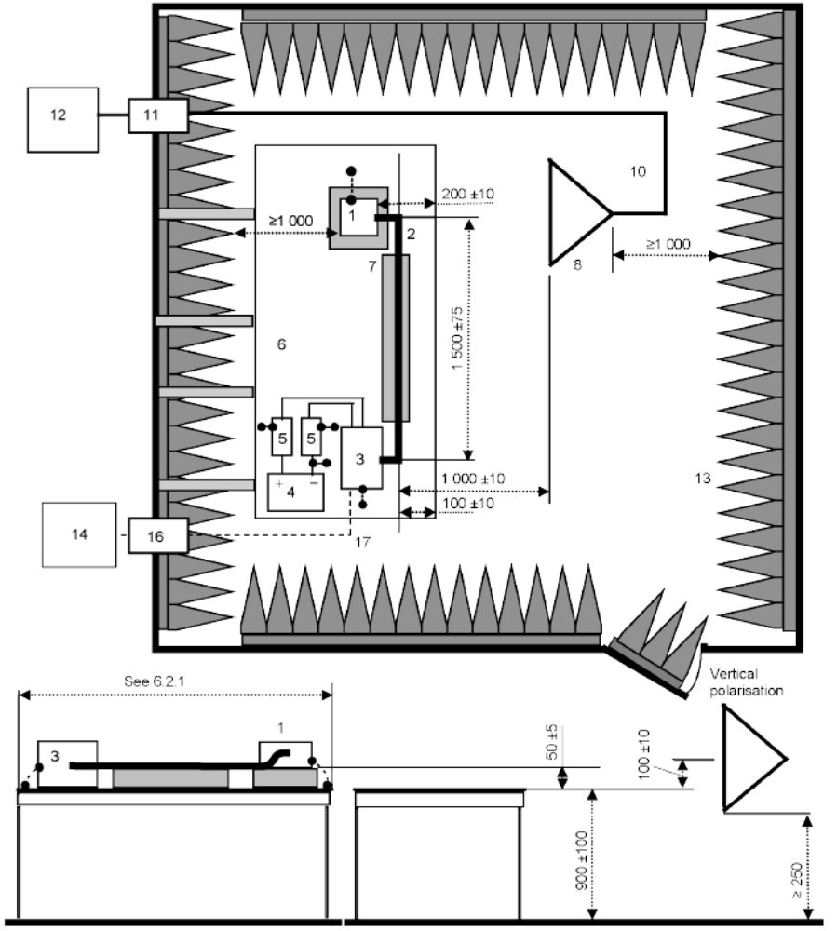
Horn Antenna Setup
Horizontal and Vertical Polarization

Slide 25
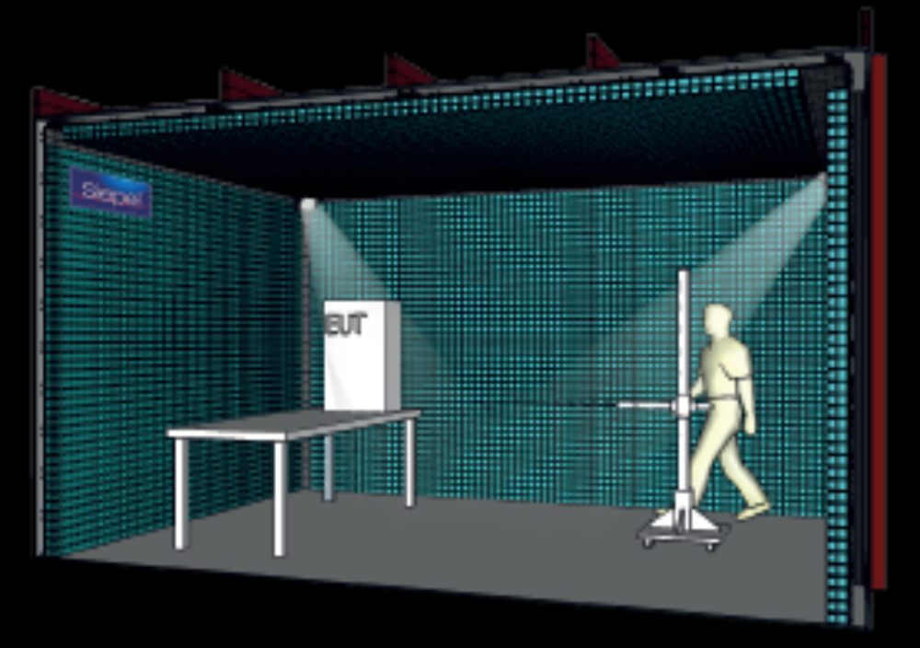

Slide 26
Chamber Verification Methods
Annex J “ALSE performance validation 150 kHz to 1 GHz”
General
  Intended to establish repeatability of results between different chambers
  For component testing per 6.5
  Choice of 2 methods, either satisfies the verification process
    Reference measurement method
    Long Wire antenna method
  Both methods utilize standard size validation ground plane

Slide 27
Reference Measurement Method
Same receive antennas used for reference measurements and ALSE verification
Transmit Antenna
  Small monopole, biconical or shortened dipole
Two steps
  Reference measurement (RM) taken in OATS or similar (ALSE allowed with qualification)
  ALSE measurement taken with normal setup (Clause 6.5)
Deviation (C_{T}) between reference and ALSE measurements must be within defined tolerance
Transmission and measuring equipment
  Network Analyzer
  Spectrum analyzer or receiver
  Tracking generator or separate signal generator

Slide 28
Transmitting Antenna
Ferrites, 50 Ohm at 25MHz and 110 Ohm at 100 MHz placed every 20cm on transmitting and receiving antenna cables
Cable routed toward back of RGP
<30 MHZ short passive monopole in vertical position
  Height including drive unit, <500mm
  Monopole diameter ,10mm
  Optional top loading disc diameter, ,120mm
  3rd port is unterminated
>30 Mhz, small biconical or shortened dipole placed in EUT harness location under normal testing
  Tip to tip dimension <40 cm

Slide 29
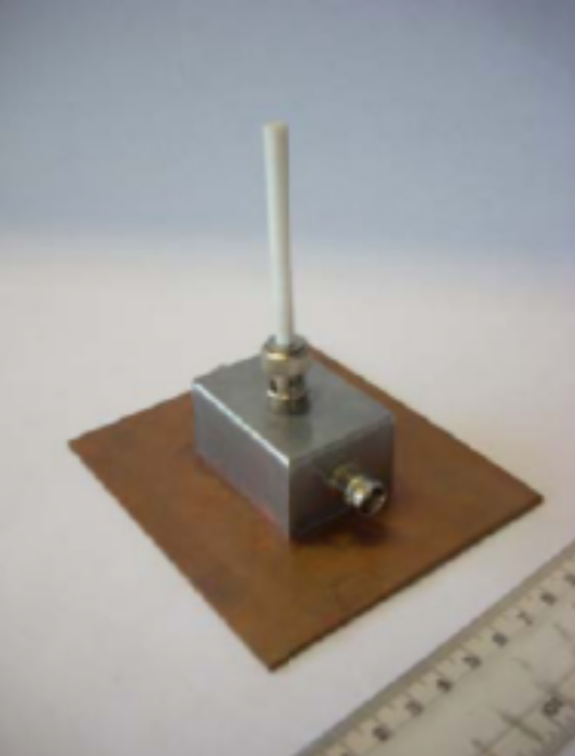
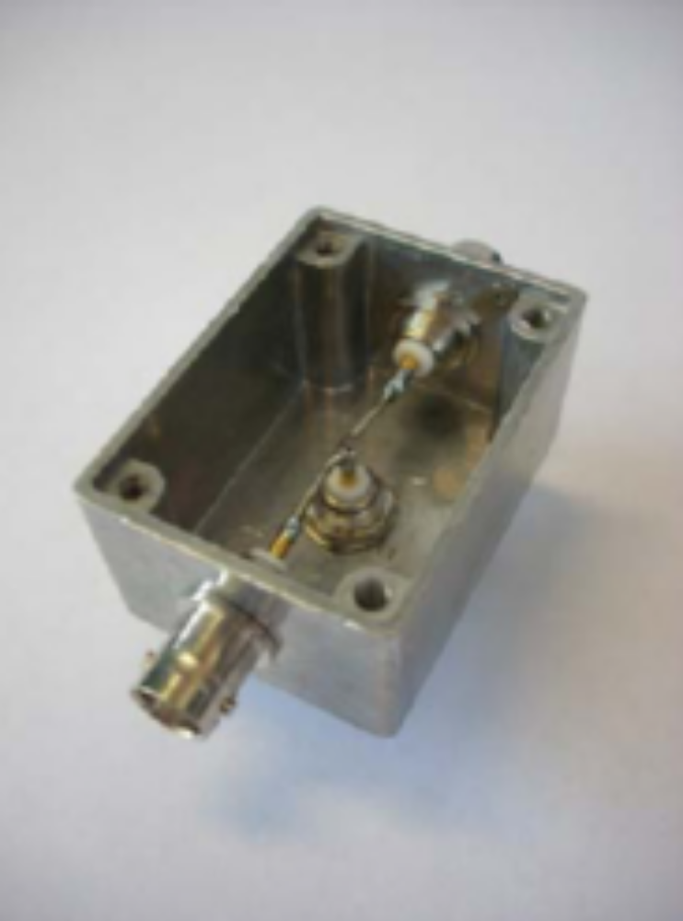
<30mm Transmit Monopole

Slide 30
Reference Measurement Method:
Transmission Coefficient Measurement (C_{T})
Normal receive antennas used in Emissions measurement
Transmitted power measured, dropped 10 dB and measured again to confirm no overload condition in measurement system
Measurement procedure similar to SAC NSA method
Direct conducted measurement taken by connecting transmit and receive antenna cables (M₀)
Measurement made with transmit and Receive antenna (M_{A})
C_{T} = M_{A} - M₀

Slide 31
Reference Measurement Method:
Transmission Coefficient Measurement (C_{T})
Frequency Step size:
  Same used for ALSE and Reference measurements
  481 frequencies used
  150 frequencies from 250 kHz to 29.95 MHz (200 kHz step size)
  170 frequencies from 30 MHz to 199 MHz (1 MHZ step size)
  161 frequencies from 200 MHz to 1,000 MHz (5 MHz step size)
Initial Noise floor measurement taken with transmit antenna disconnected
All subsequent C_{T} measurements made must be at least 10dB above noise floor measurement

Slide 32
Reference (C_{T}) Measurements < 30 MHz
Permissible to use ALSE ground floor if
  3 C_{T} measurements are taken with each antenna both moved more than 0.3m from any other measurement position
  the difference of 3 measurements is < 2dB, any one can be used as a reference measurement
  If >2dB, ALSE site cannot be used, other ALSE site or OATS then used

Slide 33
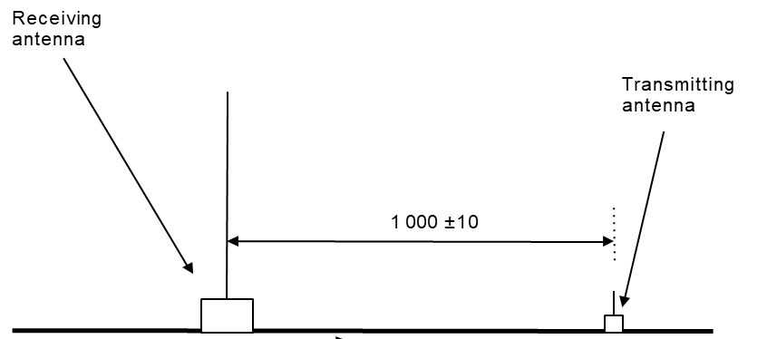
Side View of antenna configuration for RM below 30 MHz

Slide 34
Reference (C_{T}) Measurements > 30 MHz
Conducted on Reference Test Site
OATS, Weather Protected OATS, SAC (CISPR16-1-4)
Elevated Validation RGP required from 30 MHz to 1 GHz
2.5m x 1m (not the same as RGP as for ALSE or EUT Testing)
Bonded to Reference Test Site ground plane floor by single strap
Single Strap
  100 (+11, -0)mm wide, 2.5 mΩ
  Centered on rear length of Validation RGP

Slide 35
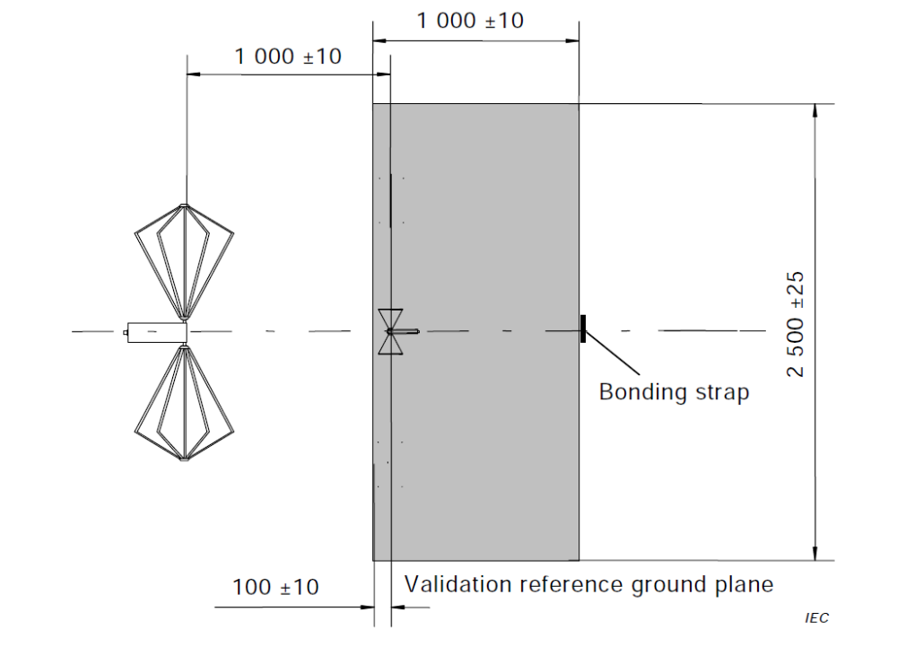
Antenna Configuration for reference (C_{T}) measurement
>30 MHz
(Top View)

Slide 36
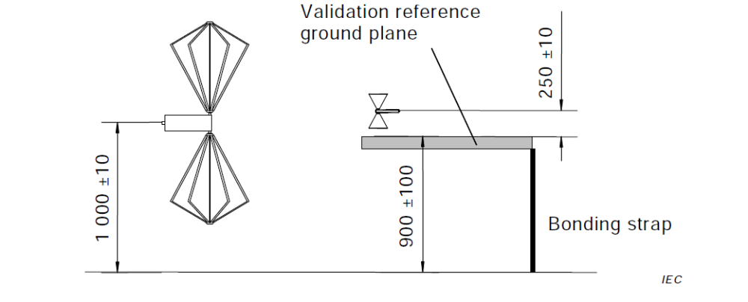
Antenna Configuration for reference (C_{T}) measurement >30 MHz (Side View)

Slide 37
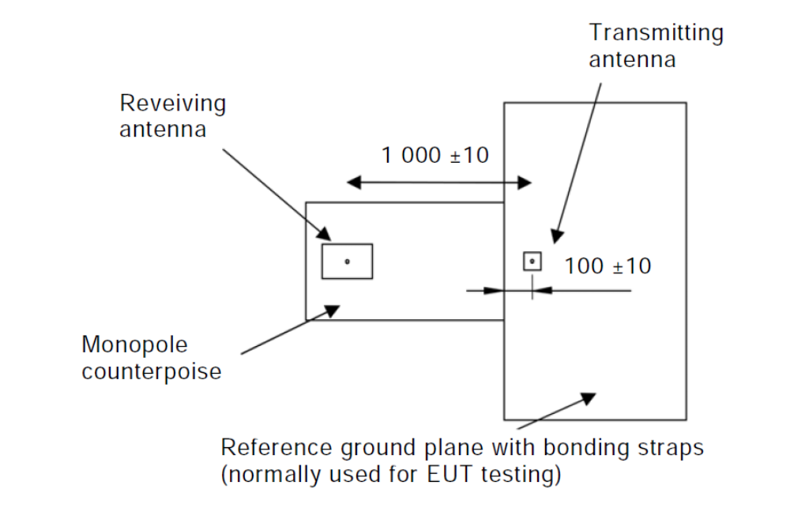
ALSE (C_{T}) Measurement < 30 MHz
Same physical layout, RGP size and bonding, RF Absorber, as EUT Testing
Monopole Antenna Counterpoise connected to table
Transmitting antenna placed on RGP at center of test harness normal location

Slide 38
ALSE (C_{T}) Measurement >30 MHz
Transmit Antenna position same as Reference (C_{T}) Measurements >30 MHz but with EUT setup (layout, bonding, grounding straps, etc)

Slide 39
ALSE (C_{T}) Measurement Deviation < 30 MHz
Reference measurement (Reference Site Ground Plane Floor) compared to ALSE measurement (typical EUT setup)
Δ _{<30 MHz} = C _{T Reference} - C _{T ALSE} Δ in dB
Count number of data points that Δ _{<30 MHz} = + 6dB

Slide 40
ALSE (C_{T}) Measurement Deviation > 30 MHz
Reference measurement (single strap bonded RGP) compared to ALSE measurement (typical EUT setup) at both polarities
Δ _{> 30 MHz Vert} = C _{T Reference Vertical} - C _{T ALSE Vertical} Δ in dB
Δ _{> 30 MHz Horiz} = C _{T Reference Horizontal} - C _{T ALSE Horizontal} Δ in dB
Count number of data points that Δ _{>30 MHz Vert} = + 6dB
Count number of data points that Δ _{>30 MHz Horiz} = + 6dB

Slide 41
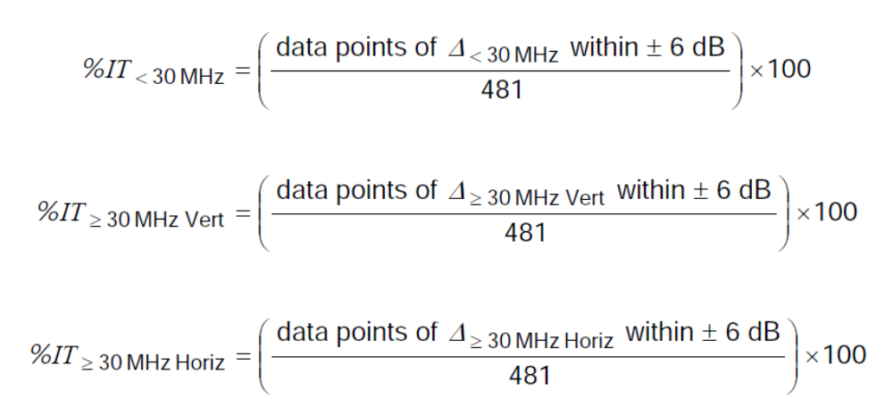
% In Tolerance (%IT) Calculation
First calculate %IT for each data set

Slide 42
% In Tolerance (%IT) Calculation
Next, Find minimum %IT data points for two data sets >30 MHz
Finally, calculate total percentage of Data Points within the +/- 6dB requirement over entire frequency range of 150 kHz to 1000 MHz

Slide 43
Total %IT 150 kHz to 1000 MHz Ref Method
ALSE and its installation is compliant with the requirements of this validation method if
Total %IT _{150 kHz to 1000 MHz Ref Method} > 90%
Difference between reference and ALSE measurements will NOT be used:
  As a correction factor for emissions measurements of an EUT, or
  To produce an antenna factor for the receiving antenna

Slide 44
Long Wire Antenna Measurement
Test Transmit Antenna
Ferrites, 50 Ohm at 25MHz and 110 Ohm at 100 MHz placed every 20cm on transmitting and receiving antenna cables
Cable routed toward back of RGP
Radiating Antenna is
Brass rod (4 + 0.2 mm) diameter
Height of (50 + 2 mm) between ground plane and closest point of rod
Held by 2 metallic sheet angles separated by (500 + 5 mm)
Type N connectors integrated in angles as rod support

Slide 45
Long Wire Test Transmit Antenna
Rod located (100 + 2 mm) from ground reference edge and at center of cabling harness used for EUT Testing
Metallic sheet angles bonded to GRP by screws or plastic clamps DC resistance < 2.5 mΩ
Load end of radiator terminated with (50 + 7.5) Ω RF load (max VSWR 1.2:1 from 150 kHz to 1000 MHZ) through type N connector mounted in metallic sheet angle
RF feed end of radiator connected to 10 dB, 50 Ω attenuator (max VSWR 1.2:1 from 150 kHz to 1000 MHZ) through type N connector mounted in other metallic sheet angle
RF feed cable connects RF source to 10 dB, 50 Ω attenuator

Slide 46
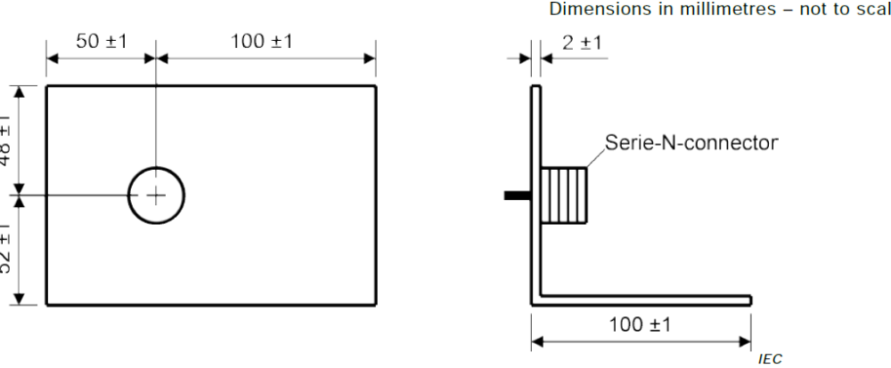
e

Slide 47
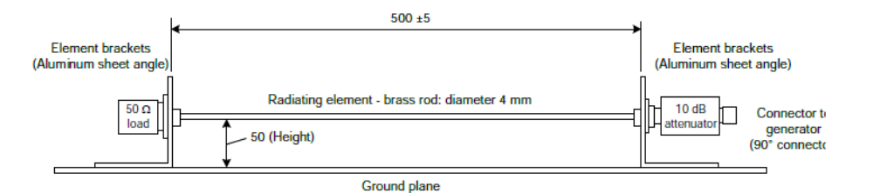

Slide 48
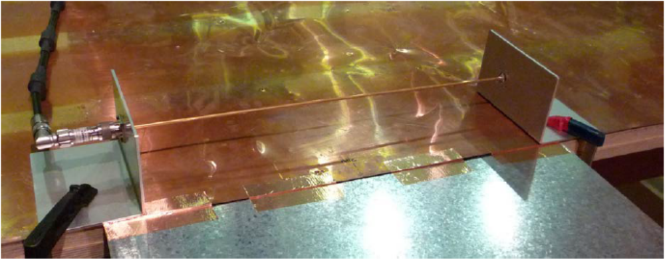

Slide 49
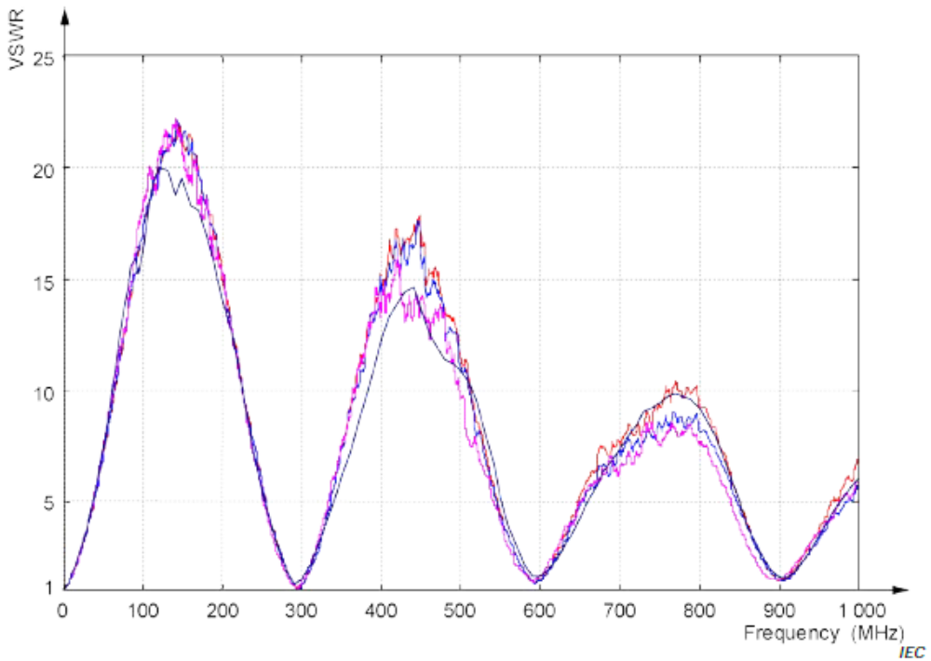
Example VSWR measured from four radiation sources (without 10 dB attenuator)

Slide 50
Long Wire Test Transmit Antenna
Normal receive antennas used in Emissions measurement
Transmitted power measured, dropped 10 dB and measured again to confirm no overload condition in measurement system
Same physical layout, RGP size and bonding, RF Absorber, as EUT Testing
Monopole Antenna Counterpoise connected to table
Transmitting antenna placed on RGP at center of test harness normal location

Slide 51
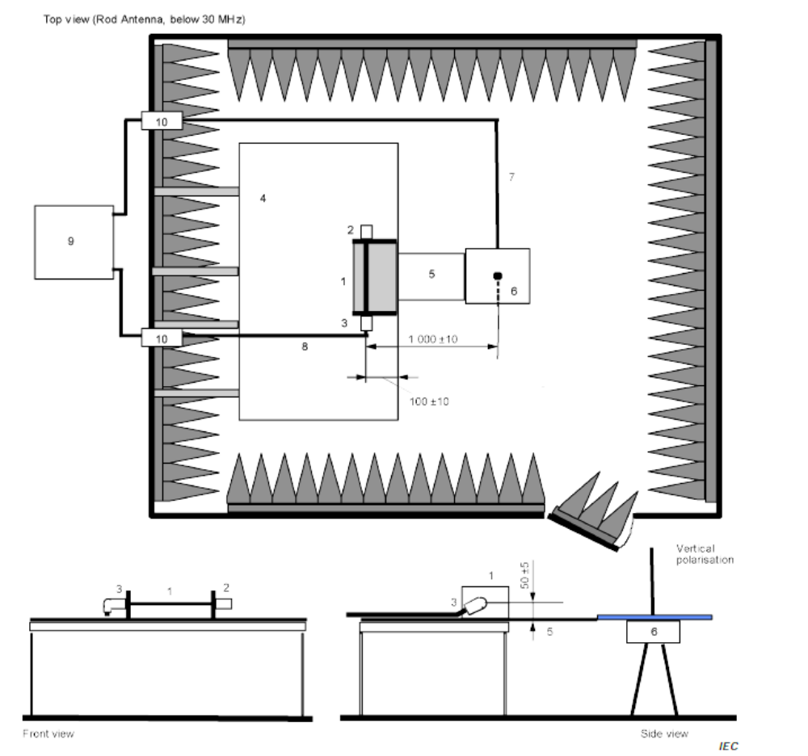
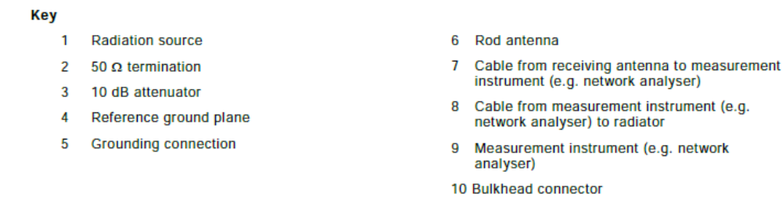
Transmit Antenna location

Slide 52
Long Wire Antenna Measurement Procedure
Same frequency Step size as Reference Method
Direct conducted measurement taken by connecting transmit and receive antenna cables (M₀)
Measurement made with transmit and Receive antenna (M_{A})
Signal Generator amplitude set to 1V rms (120 dB (uV)) for both M₀ and M_{A}
Equivalent field Strength (E_{eq})= 120 dB(uV) + (M_{A} - M₀) + k _{AF}
k _{AF} is antenna factor of receive antenna in dB(1/m)

Slide 53
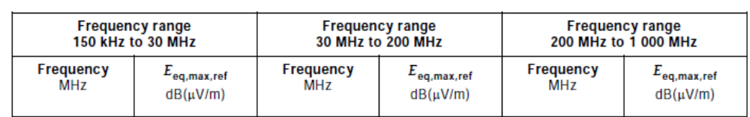
Long Wire Antenna Measurement Procedure
Above 30 MHz, measurement performed for both Horizontal and Vertical Position and Equivalent Field Strength (E_{eq}) calculated
E_{eq, horiz}
E_{eq, vert}
For each frequency, E_{eq,max} is derived as maximum of E_{eq, horiz} and E_{eq, vert}
Table J1 lists all frequencies E_{eq,max,ref} in dB(uV/m) for calculations

Slide 54
Deviation of ALSE measurement from the reference data
For each frequency
Δ _{Long wire Method} = E_{eq,max} – E_{eq, max,ref} Δ in dB
Where
  E_{eq,max} is the maximum field measured at a particular frequency (maximum of both horizontal and vertical polarizations, where applicable)
  E_{eq,max,ref} is the modelled reference field as shown in table J1 at the same frequency as E_{eq,max}

Slide 55
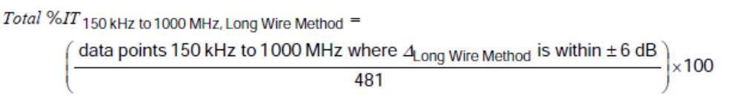
Long Wire Antenna Test Requirements
Total percentage of data points within +6 dB calculated over entire frequency range (Total %IT)
data points 150 kHz to 1000MHz whereΔ _{Long wire Method} is within +6dB is the number of frequencies where Δ _{Long wire Method} is within +6dB as evaluated above

Slide 56
Total %IT 150 kHz to 1000 MHz Long Wire Method
ALSE and its installation is compliant with the requirements of this validation method if
Total %IT 150 kHz to 1000 MHz Long Wire Method > 90%
Difference between reference and ALSE measurements will NOT be used:
  As a correction factor for emissions measurements of an EUT, or
  To produce an antenna factor for the receiving antenna

Slide 57
Influence Parameters of Chamber Validation Test
Reference Ground Plane (RGP)
RGP bonding straps (number, size, horizontal versus vertical)
Absorber performance

Slide 58
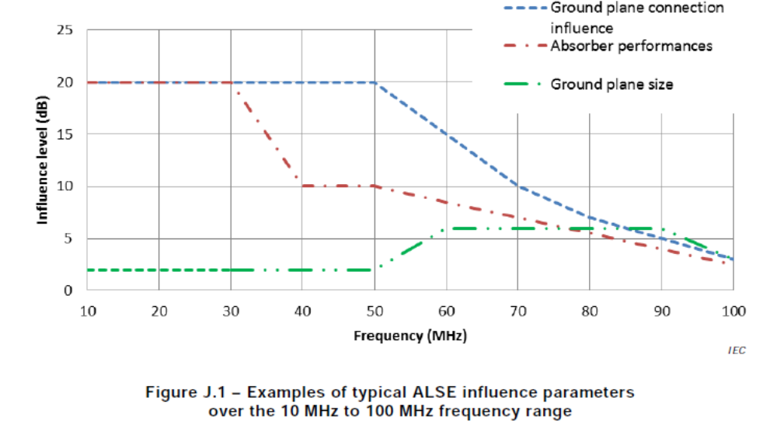

Slide 59
Influence Parameters of Chamber Validation Test
Modifications on one or more should help to improve ALSE performance
Between 10 MHZ and 30 MHz, most important parameters are ground plane connections and absorber performance
In some cases, <30 MHz, resonances may be observed, to reduce the influence of resonance:
  Apply foam block absorber between bottom of receive antenna and floor
  Bond counterpoise of receive antenna with additional grounding straps (length to width ratio of 7:1) to floor on opposite side from connection to RGP

Slide 60
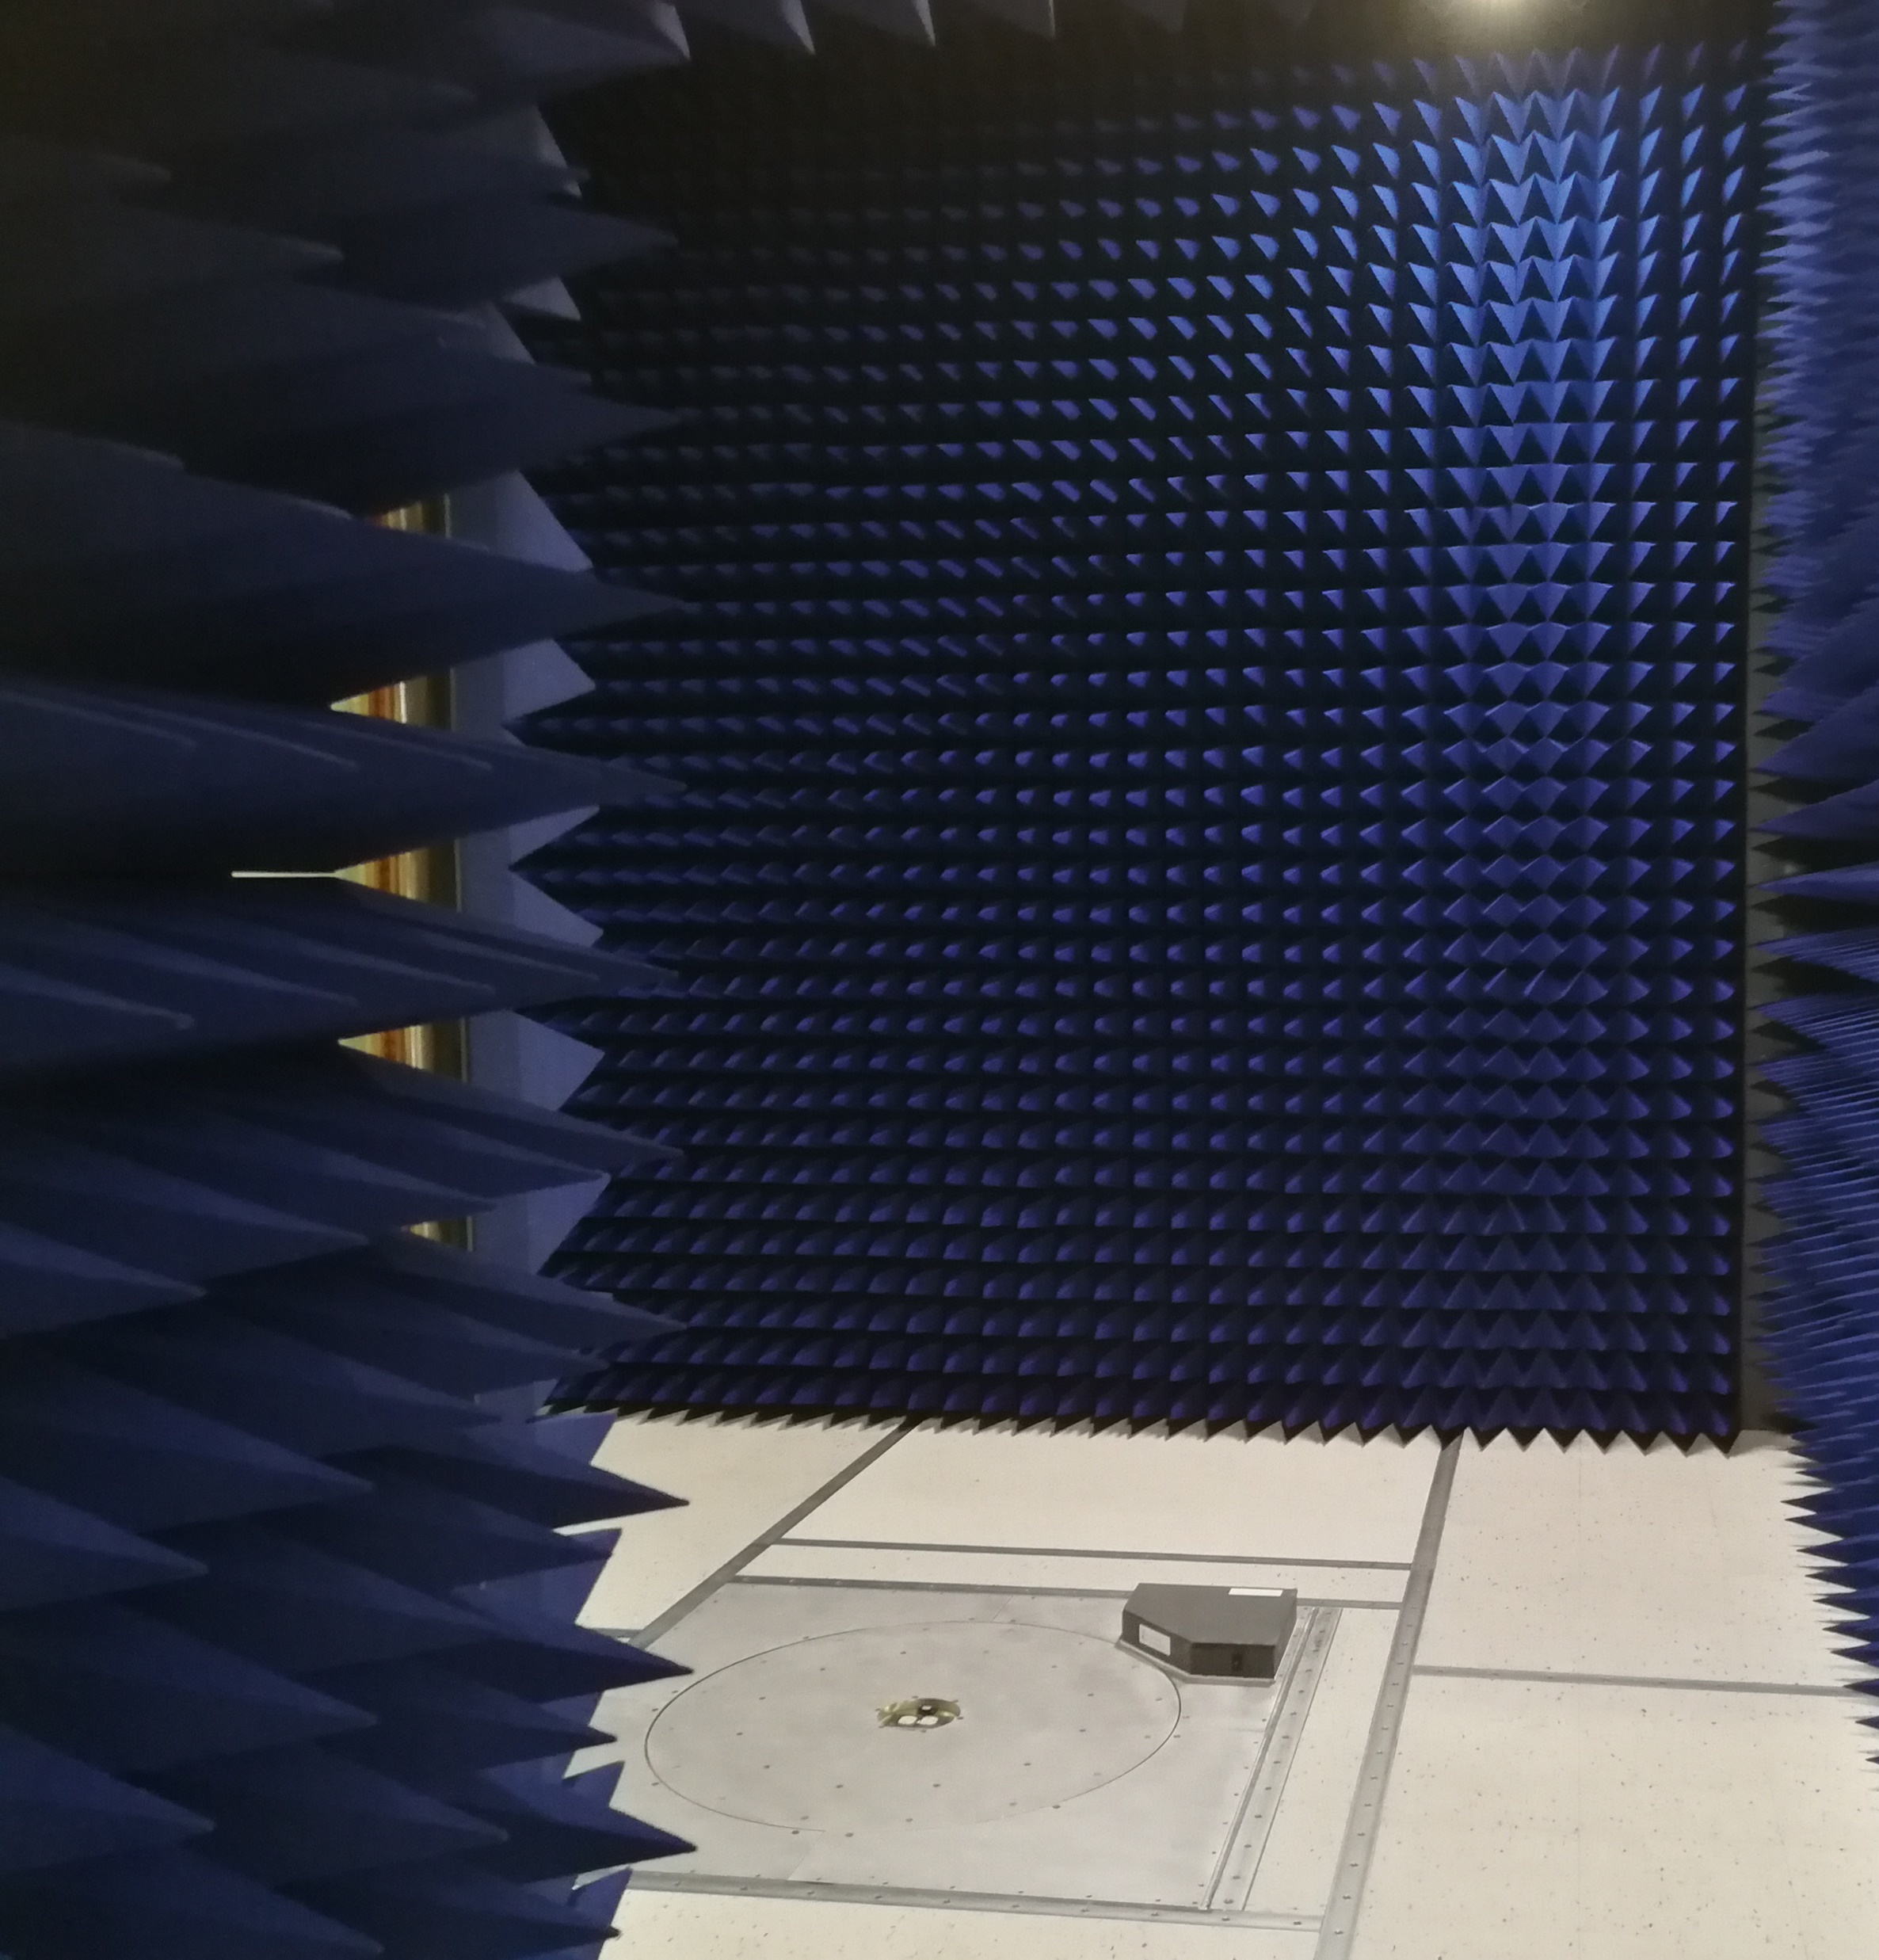
Thank you!
Questions?
Get in Touch
Louis A. Feudi
U.S. Channel Sales Manager
lfeudi@raymondemc.ca
1-800-EMC-1495
raymondemc.ca

