Slide 1


Comparing Standards
Karen Burnham
Principal Scientist
Electro Magnetic Applications, Inc
Lakewood, CO

Slide 2
How to Make Standards Less Boring?

Slide 3

How to Make Standards Less Boring?

Slide 4

Competition!

Slide 5
Competition!
OK, well, really, it’s going to be more about comparisons….

Slide 6

Competition!
OK, well, really, it’s going to be more about comparisons….

Slide 7
Radiated Emissions

Slide 8
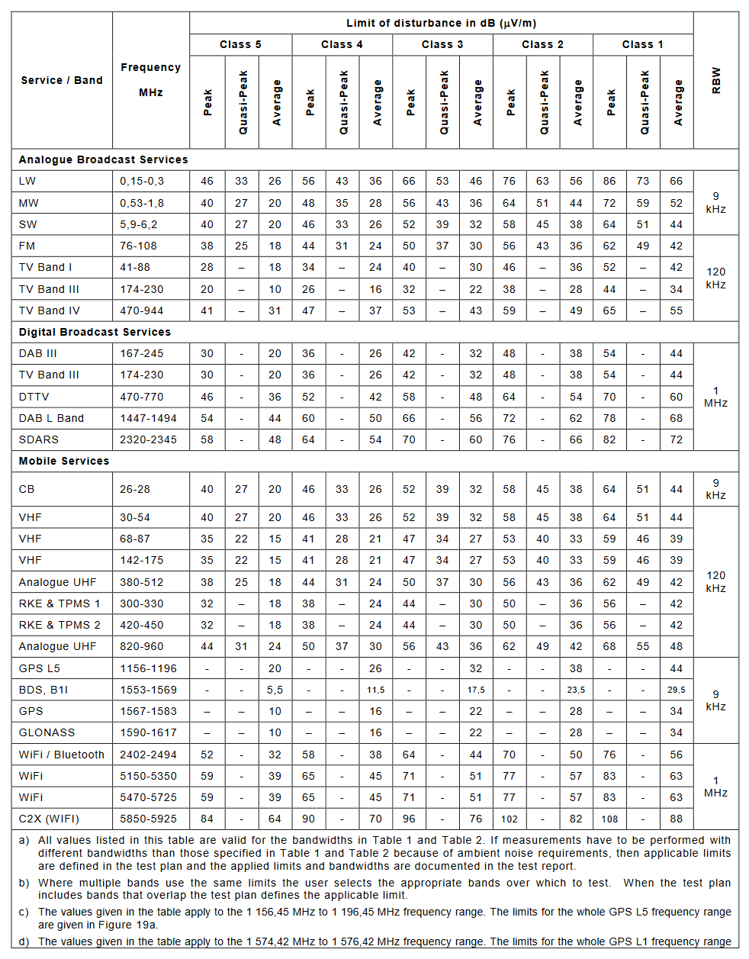
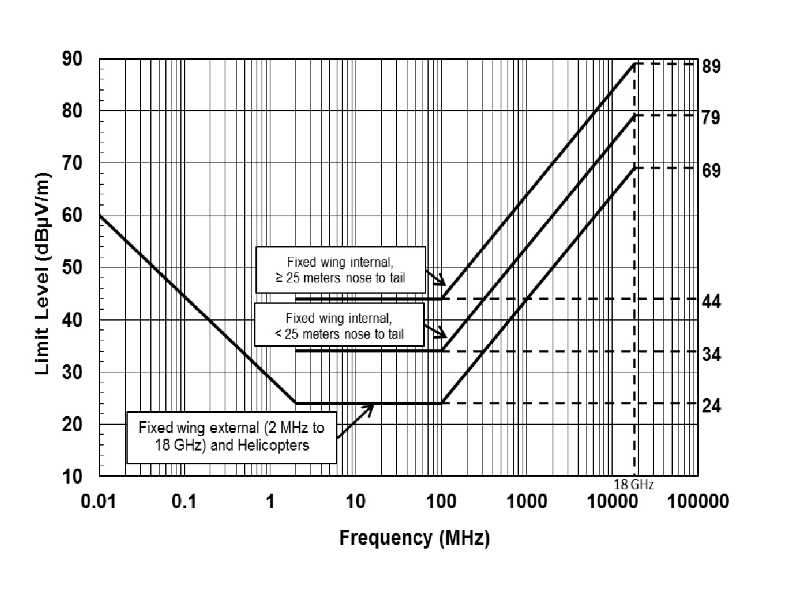
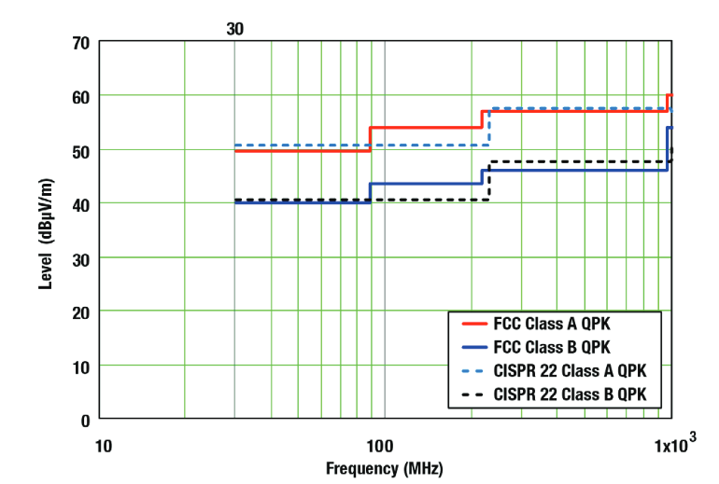
Component Radiated Emissions
CISPR 25
MIL-STD-461 RE102
FCC
[Uses ANSI C63.4 as test method]

Slide 9
Component Radiated Emissions
CISPR 25
MIL-STD-461 RE102
FCC
1 meter
3 or 10 meters
1 meter

Slide 10
Component Radiated Emissions
CISPR 25
MIL-STD-461 RE102
FCC
Near Field
Far Field
Near Field

Slide 11
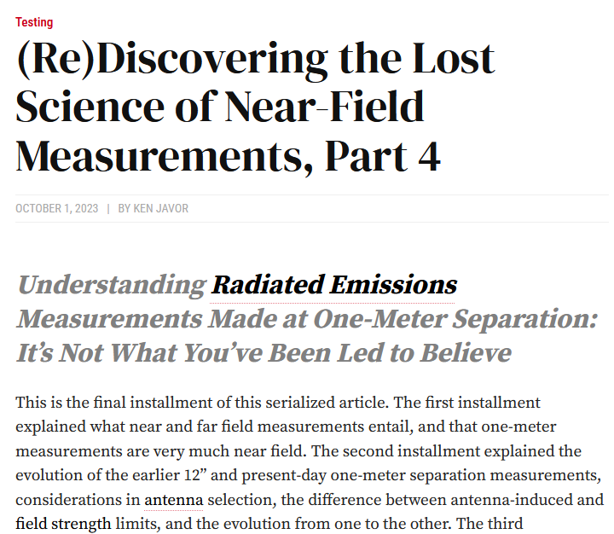

Ken Javor Says…
Don’t extrapolate from 1 m to 3 or 10 m measurements (or vice versa)!
https://incompliancemag.com/rediscovering-the-lost-science-of-near-field-measurements-part-4/

Slide 12
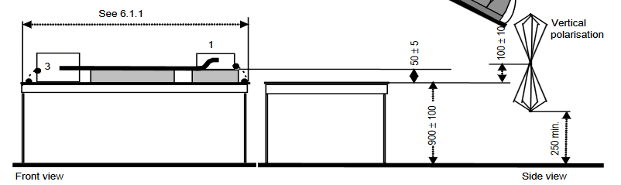
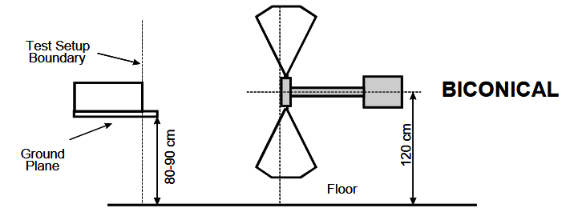
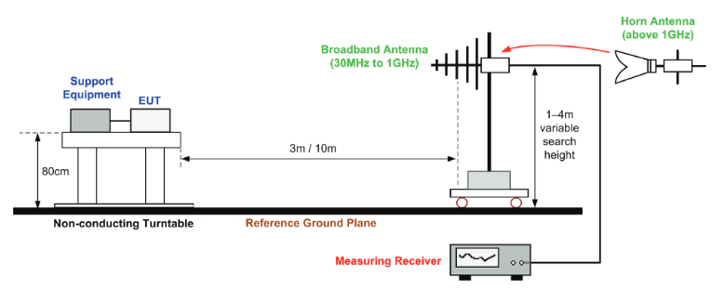
Component Radiated Emissions
CISPR 25
MIL-STD-461 RE102
[Uses ANSI C63.4
as test method]
FCC

Slide 13
Component Radiated Emissions
CISPR 25
Conductive Ground Plane
MIL-STD-461 RE102
All Dielectric
[Uses ANSI C63.4
as test method]
FCC

Slide 14
Conducted Emissions

Slide 15
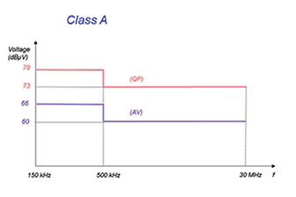
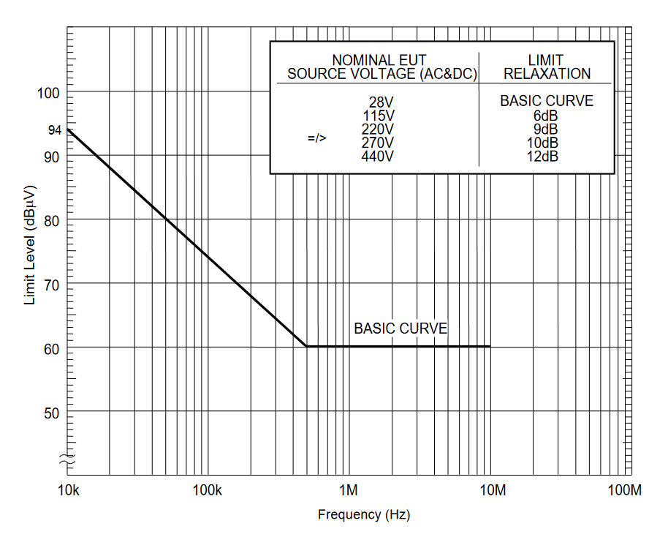
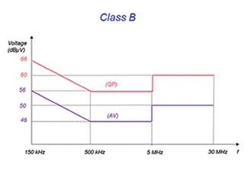
Conducted Emissions
MIL-STD-461 CE102
FCC
(PK)

Slide 16
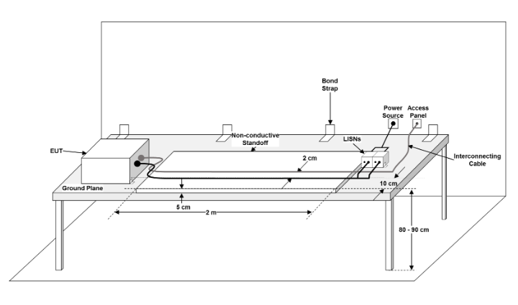
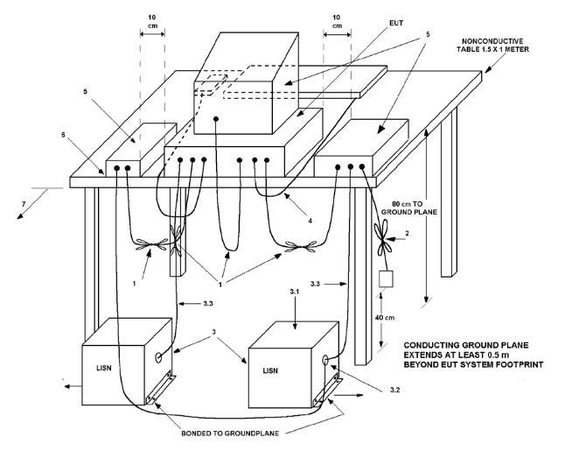
Conducted Emissions
MIL-STD-461 CE102
FCC
ANSI C63.4

Slide 17
Conducted Emissions
MIL-STD-461 CE102
FCC
5 cm to Ground Plane
80 cm to Ground Plane
ANSI C63.4

Slide 18
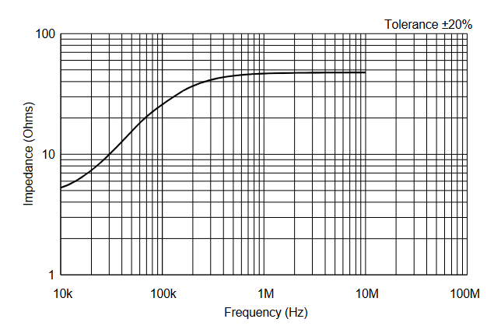
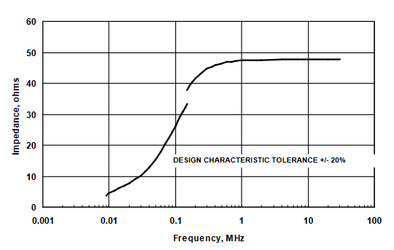
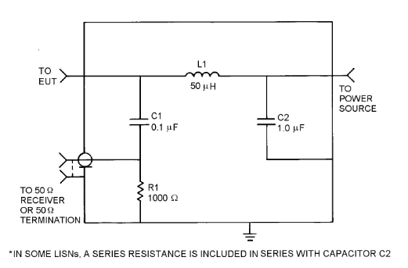
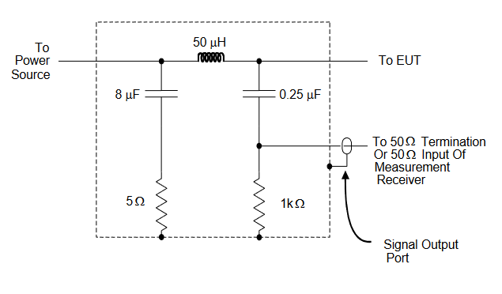
Conducted Emissions
MIL-STD-461 CE102
FCC

Slide 19
Conducted Emissions
MIL-STD-461 CE102
FCC
Assumes DC Power
Assumes AC Power

Slide 20

Conducted Emissions
GEVS

Slide 21
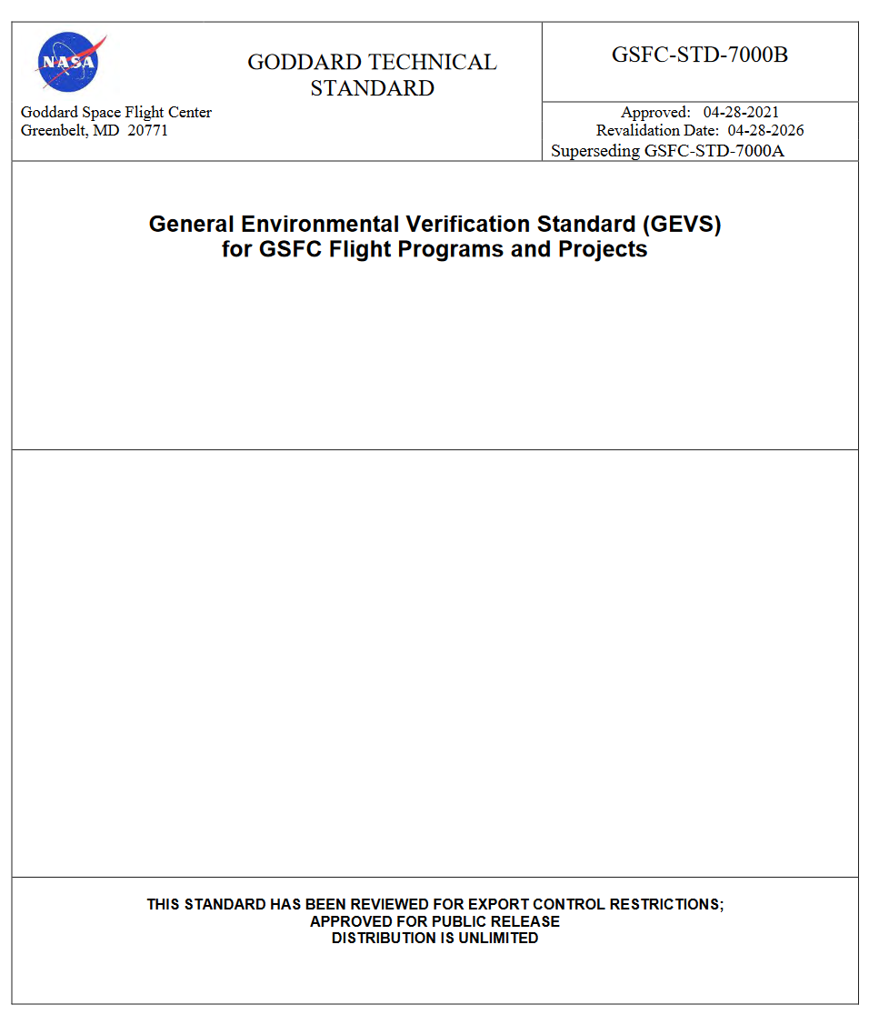
Conducted Emissions
GEVS

Slide 22
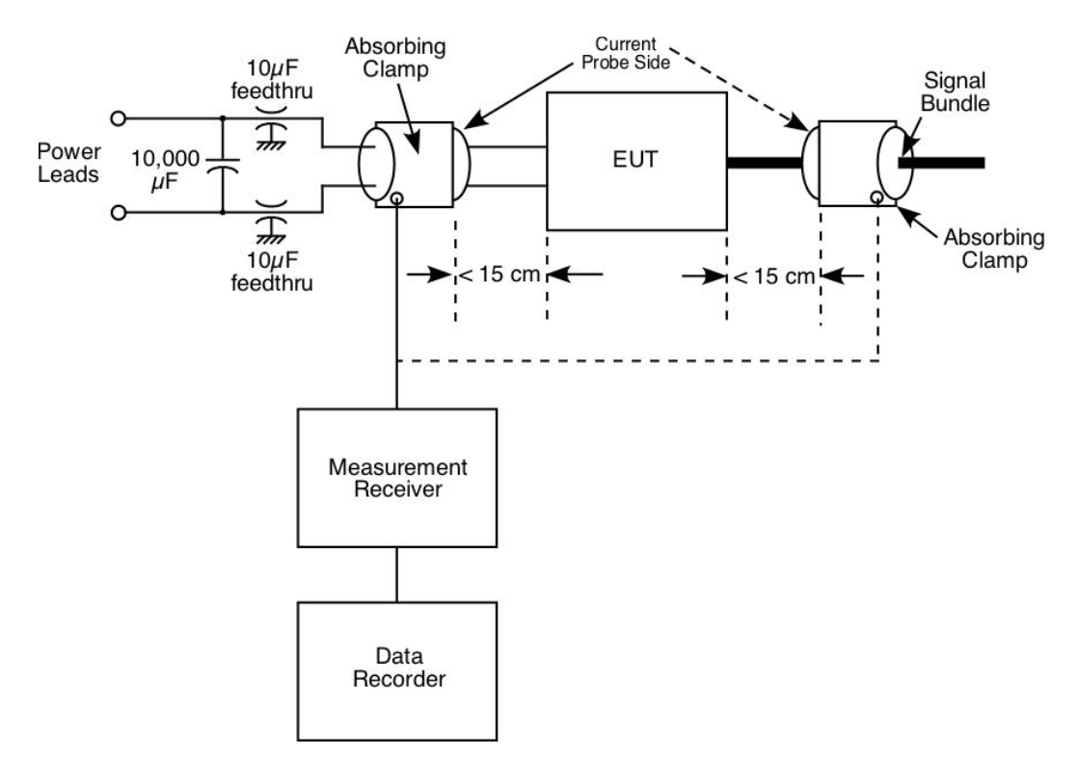
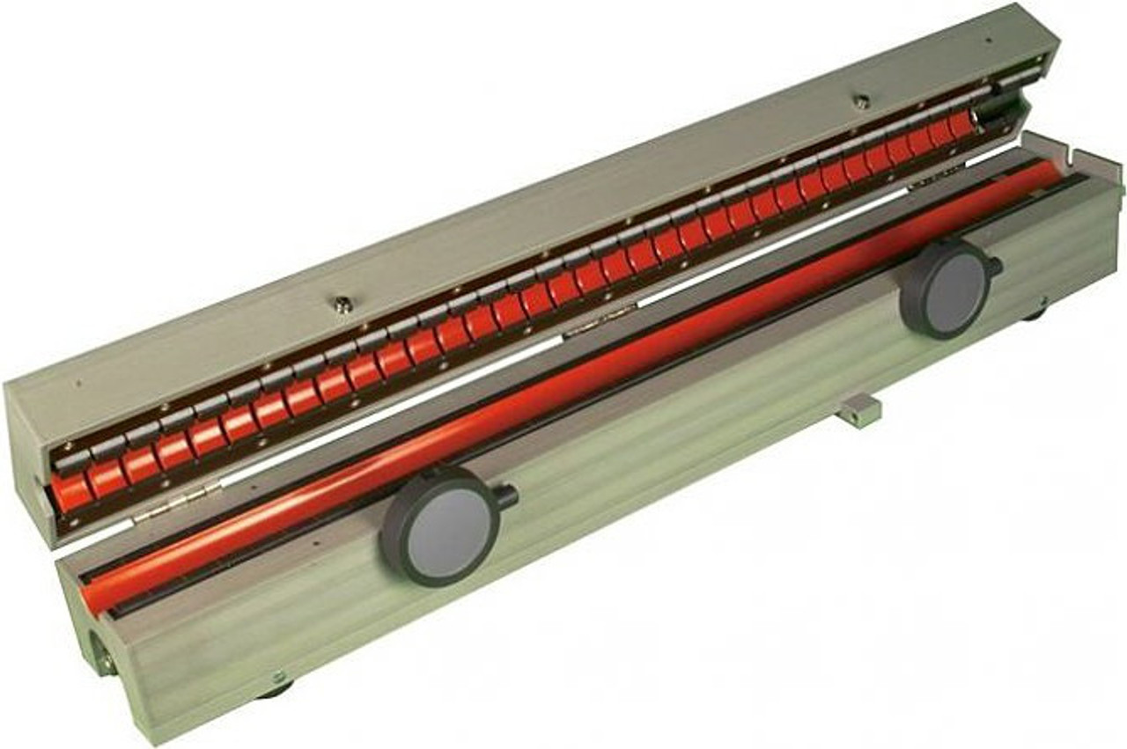
Conducted Emissions
GEVS
CISPR 16 Absorbing Clamp

Slide 23
Conducted Emissions
GEVS
CISPR 16 Absorbing Clamp

Slide 24
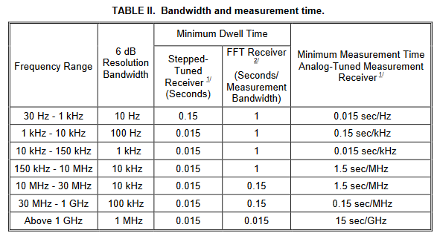
Bandwidths (CE and RE)
MIL-STD-461 (Rev G)
ANSI C63.4 (2014)
Refers to ANSI C63.2 and CISPR 16-1-1
Generally:
150 kHz – 30 MHz, RBW = 9 kHz
30 MHz – 1 GHz, RBW = 120 kHz

Slide 25
ESD

Slide 26
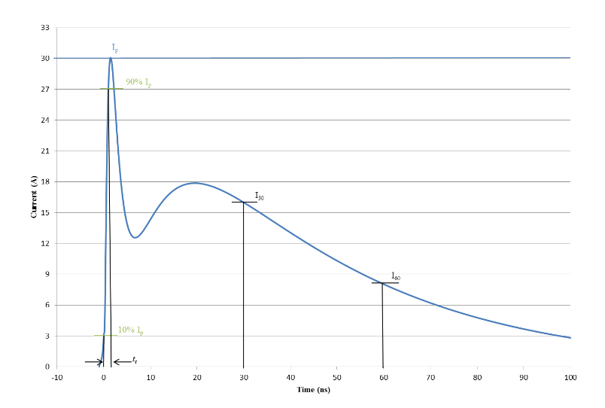
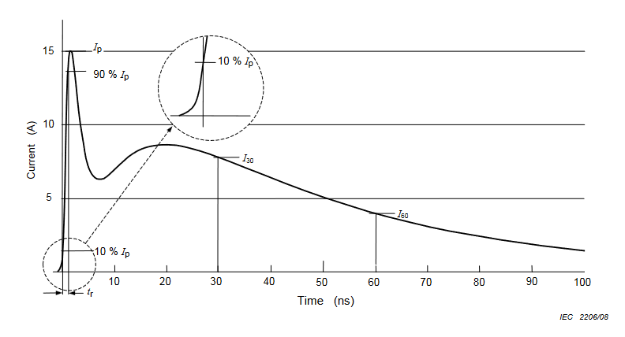
ESD
MIL-STD-461 CS118
IEC 61000-4-2

Slide 27
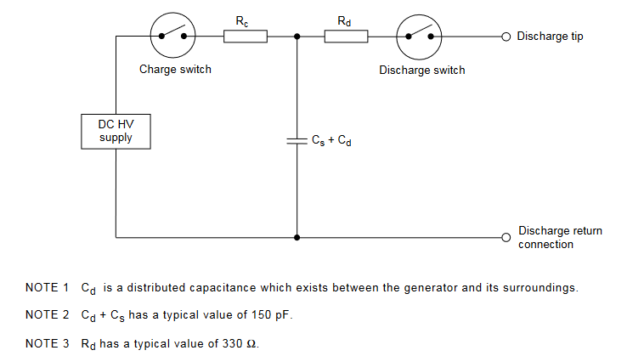
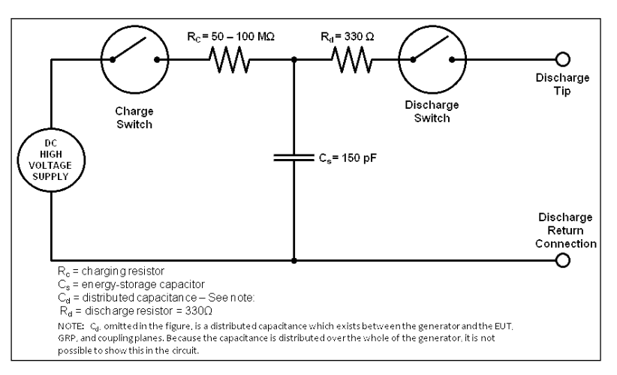
ESD
MIL-STD-461 CS118
IEC 61000-4-2

Slide 28
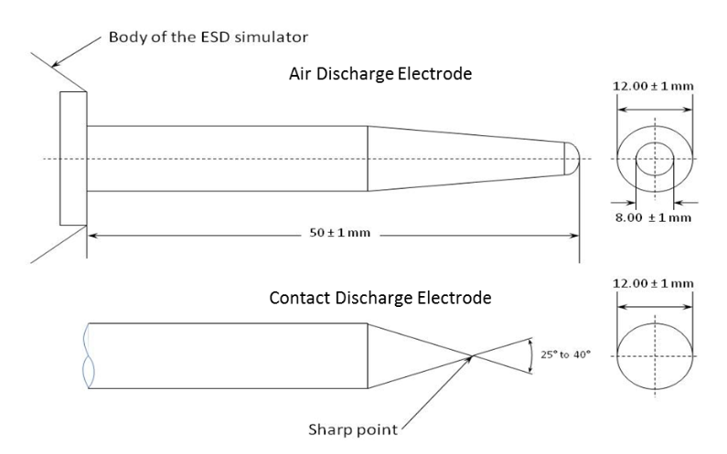
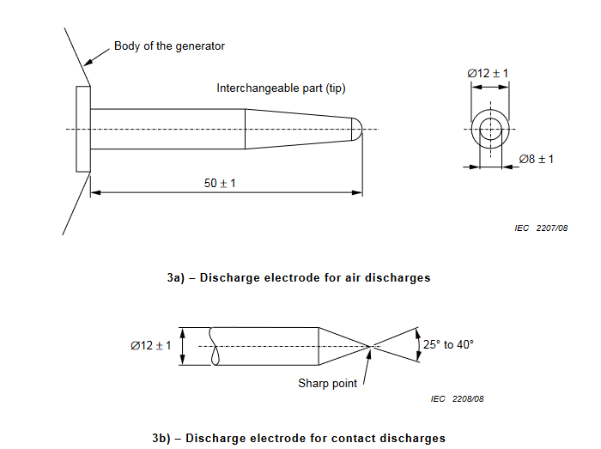
ESD
MIL-STD-461 CS118
IEC 61000-4-2

Slide 29
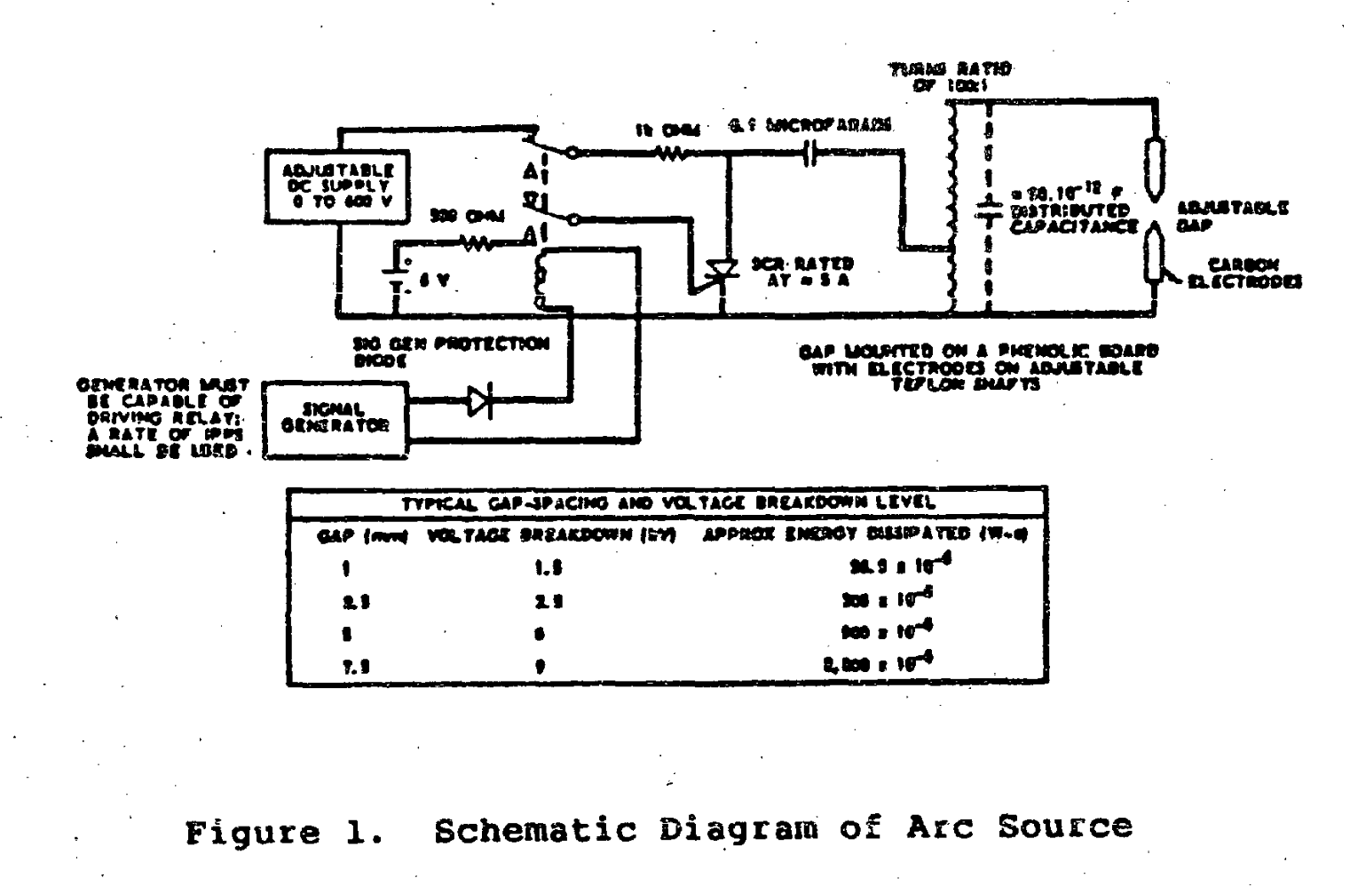
ESD – MIL-STD-1541A (1987)

Slide 30
ESD – MIL-STD-1541A (1987)
Not Based On Human Body Model

Slide 31
Filters

Slide 32
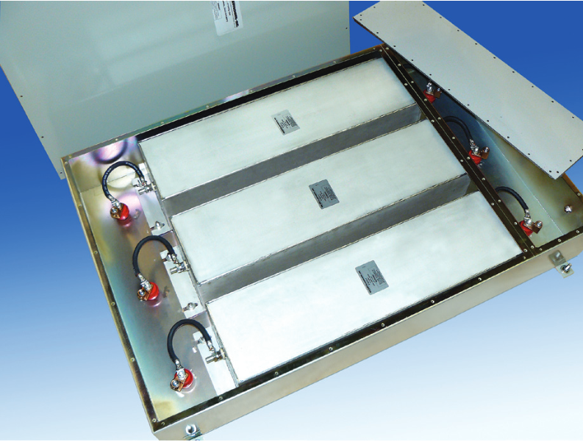
Filters
“Our shielded room filters are designed to meet or exceed
the requirements of MIL-STD-220 with 100 dB attenuation
from 14 KHz to10 GHz.”

Slide 33
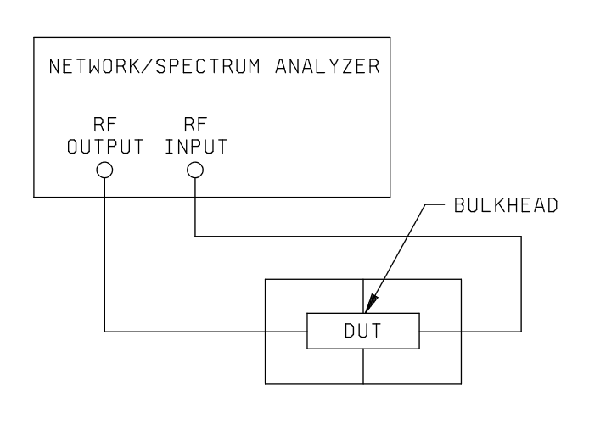
Filters – MIL-STD-220C (2009)
“This standard covers a method of measuring, in a 50 ohm system, the insertion loss of
feed-through suppression capacitors, and of single and multiple circuit radio frequency (RF) filters at
frequencies up to 10 gigahertz (GHz).”

Slide 34
Filters

Slide 35
Filters
Coax Cable Connections
For RF Filters
NOT Coax Cable Connections
NOT RF Filters

Slide 36
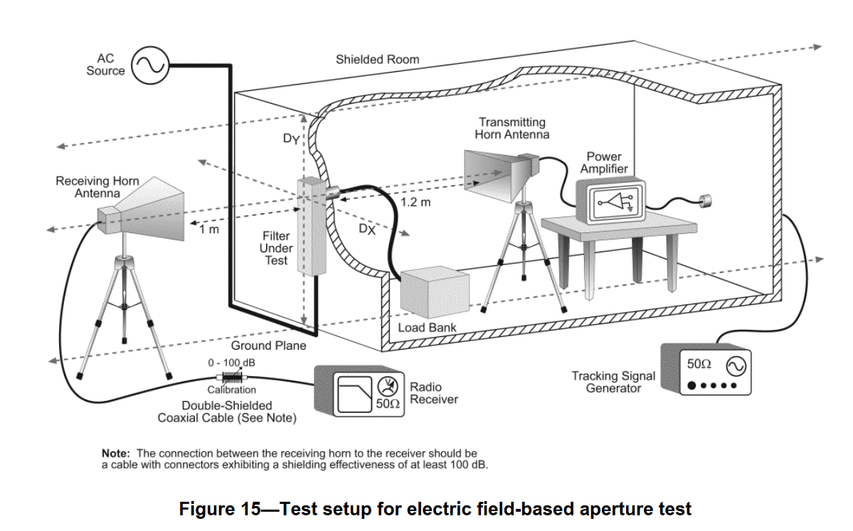
Filters – IEEE 1560 (2005)
“The scope of this standard is to develop a standard method of measurement for evaluating the
electromagnetic and radio frequency suppression capability of power-line filters in the frequency range of
100 Hz to 10 GHz.”

Slide 37
Pitch for Standards
I’d like to encourage everyone in the audience to consider the opportunities to get involved in EMC standards, whether through IEEE, ANSI, SAE, etc.
Standards are written by and for working engineers, not handed down from a higher plane of being
If there are standards that touch on your work areas, take a look at getting involved
Contact me if you have any questions, and I can help put you in touch with the right people
EMC Standards are written by people like YOU

Slide 38
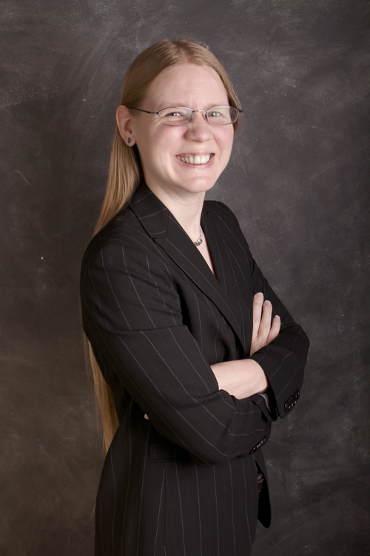
Questions?
Karen Burnham, Principal Scientist
Electro Magnetic Applications, Inc
www.EMA3D.com
Karen.Burnham@ema3d.com

