Slide 1
Basic Parameters of the Normalized Site Attenuation (NSA) Method for Open Area Test Sites (OATS) and Semi Anechoic Chambers (SAC) In CISPR 16-1-4 for EMC Testing for
IEEE EMC Chapter Michigan Section by
Louis A. Feudi
Raymond EMC

Slide 2
Scope
CISPR 16-1-4
Qualification of OATS
Qualification of SAC or FAR
30 MHz-1GHZ
Normalized Site Attenuation
SVSWR will not be covered

Slide 3
CISPR and IEC
Comité International Spécial des Perturbations Radioélectriques (English translation: International Special Committee on Radio Interference)
Part of the International Electrotechnical Commission (IEC)
CISPR drafts standards for controlling electromagnetic interference
For Electrical and electronic devices

Slide 4
CISPR and IEC
Two types of standards
Guideline standards – provided for use by a product standard committee as a “basic framework”
Product Specific Standards – Tailored to evaluate and verify that a specific product or product category is compliant with a specific set of requirements that can be impacted by environment, user interface, and safety requirements where applicable.

Slide 5
CISPR 16
Standard for “Specification for Radio Disturbance and Immunity measuring apparatus and Methods”
Multiple Parts
Part 2-3 describes methods of measurement of electromagnetic disturbances
Part 3 provides radio disturbance information
Part 4 covers uncertainties, statistics and limit modeling
Part 1-4 titled “Radio disturbance and immunity measuring apparatus – Antennas and test sites for radiated disturbance measurements”

Slide 6
CISPR 16-1-4:2019
Most recent publication
Guideline standard “for use by product committees of the IEC”
“specifies the characteristics and performance of equipment for the measurement of radiated disturbances in the frequency range 9 kHz to 18 GHz.”
Antennas and Test Sites

Slide 7
Compliance Test Site
Environment that assures valid, reproduceable measurement results of the rf disturbance field strengths generated by UUT
Open Area Test Site (OATS)
Semi Anechoic Chamber (SAC)
Fully Anechoic Room (FAR)
Defined in CISPR 16-1-4 for both mechanical description and verification process to ensure that sites will provide reproduceable, valid results from RF Disturbance Measurements

Slide 8
Basic Requirements
“Quiet Zone” or “EUT Volume”
Contains EUT
Produces results that will closely align with a theoretical “ideal open area test site”
perfectly flat, perfectly conducting ground plane of infinite area, and with no reflecting objects except the ground plane
method to evaluate OATS, SAC and FAR sites to as closely approximate one in an area that encompasses the EUT

Slide 9
EUT Volume
Commonly referred to as Quiet Zone
cylinder defined by the EUT boundary diameter and height, encompassing the EUT, cable racks, and 1.6m of cable length
For measurement from 30 MHz-1GHz

Slide 10
OATS
“an area characterized by cleared level terrain and with the presence of a conducting” (metallic recommended) “ground plane”
Free of obstructions (trees, buildings, electric lines, fences, no underground pipes or cables (except as needed to power site)
Optional weather protection to protect EUT and measurement antenna, rf transparent
Encompasses EUT and measurement antenna
Antenna mast , rf transparent, up to 4m
Minimum dimensions for site dependent on
measurement distance: d
Presence of a turntable

Slide 11
Minimum Dimensions
Directional emissions require measurement
  all around the unit
  Reflected off ground plane
  Up to a height of 4m
  To ensure maximization of emissions measured
In the absence of a turntable, round OATS requiring antenna to be revolved around the EUT

Slide 12
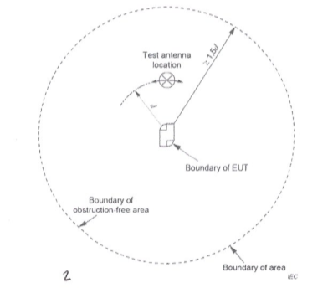
Stationary EUT
No Turntable
Note that the minimum distance of the area boundary is 1.5 times the measurement distance d (often 3, 5, or 10m).

Slide 13
OATS sans Turntable

Slide 14
Oats with Turntable
Allows rotation of the EUT
Shaped as an Ellipse
Length 2x distance d
Distance d/2 between test sample antenna and boundary behind

Slide 15
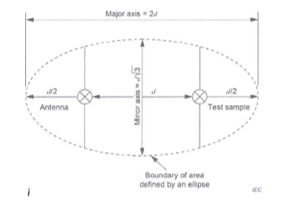
Ellipse OATS dimensions

Slide 16
Ambient rf levels classification
Class a:The ambient emissions are 6 dB or more below the measurement levels.
Class b:Some ambient emissions are within 6 dB of the measurement levels.
Class c: Some ambient emissions are above the measurement levels, but they are either widely spaced in time between transmissions to allow for a measurement to be made (aperiodic) or are continuous only on limited identifiable frequencies (i.e. FM bands).
Class d: The ambient levels are above the measurement levels over a large portion of the measurement frequency range, continually transmitting.
Quality classification d is unacceptable, yet with the increasing use of cellular towers, Wi-Fi hotspots, and other transmission sources, most OATS will need to be located in remote areas.

Slide 17
Alternatives to OATS
SAC
FAR
Both are shielded enclosures constructed of steel, with a
  door,
  honeycombed vents
  Electrical power filters
  Pipe penetrations
  Bulkhead panels
Shielding Effectiveness normally 90-110 dB from 15 kHz-40 GHz
Eliminates or drastically reduces ambient emissions

Slide 18
SAC
Shielded Enclosure
Ferrite lined on walls and Ceiling
Absorber partial lined on Walls and Ceiling
Reflective Ground plane for 30 MHz-1GHz measurements
Ferrite tile and absorber patch on floor for
  RF Measurements from 1-18 GHz
  RF Immunity generated uniform field
3, 5, and 10m measurement distances

Slide 19
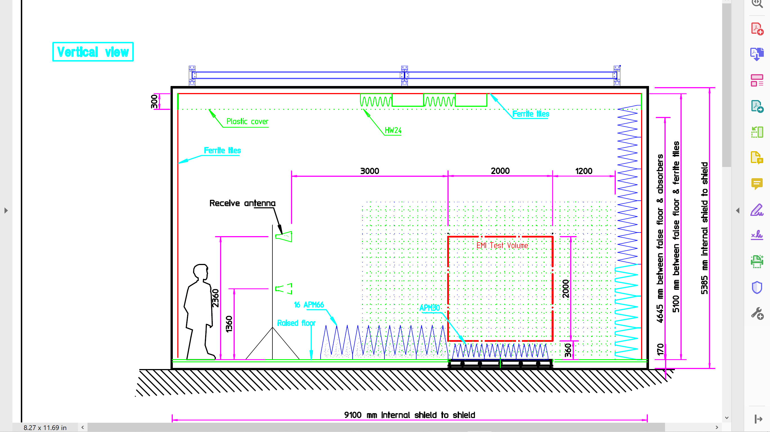

Slide 20
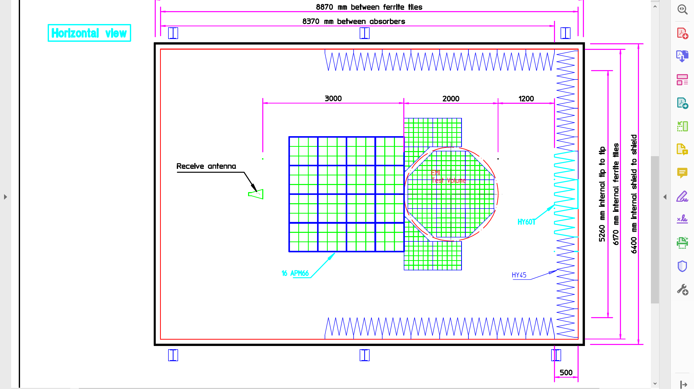

Slide 21
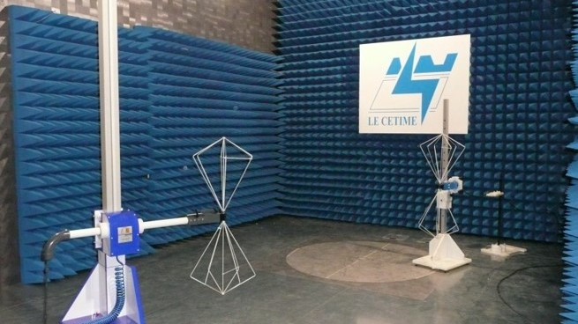

Slide 22
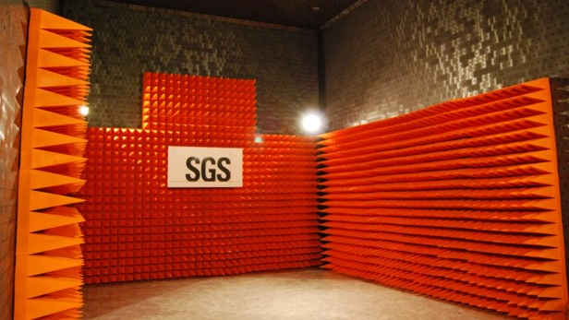

Slide 23
FAR
Shielded Enclosure
Absorber lined on walls, ceiling, and floor
Simulates free space environment
Only direct ray transmitted, intentionally or not, to the receive antenna
Absorber reduces indirect and reflected ray waves on walls, floor and ceiling

Slide 24
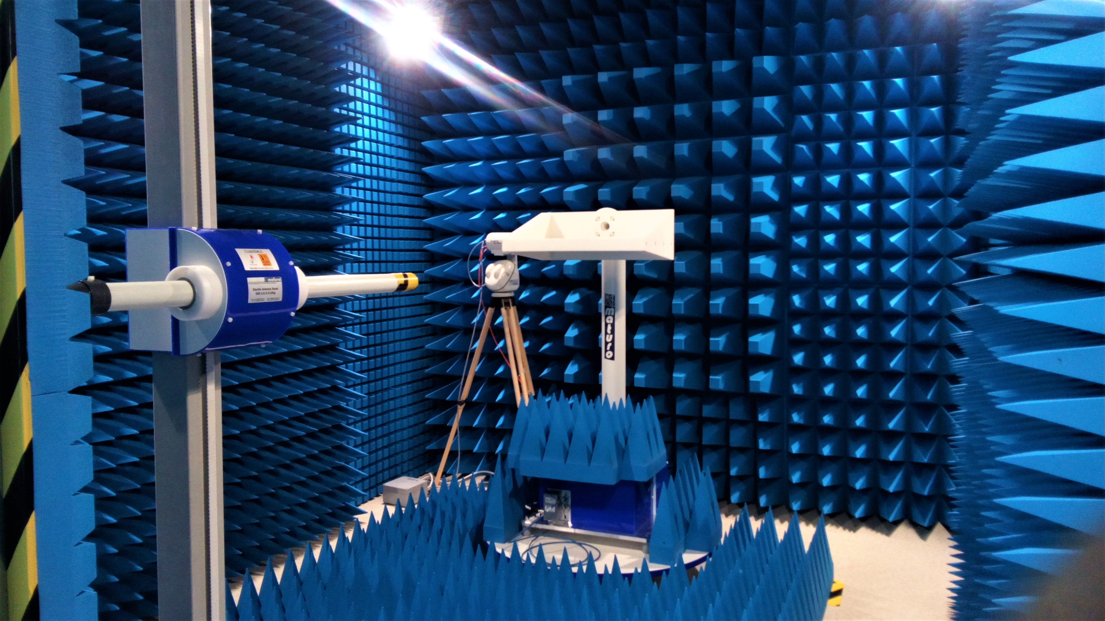

Slide 25
Normalized Site Attenuation
“minimum site insertion loss between two polarization-matched antennas located at a test site when one antenna is moved vertically over a specified height range and the other is set at a fixed height”.
Fixed height antenna located at center of OATS
Variable height antenna at specified measurement distance from transmit antenna
Broadband antenna method most commonly used for site validation
Tuned Dipoles not described in 16-1-4, section 6.4 – Test Site Validations, but refers to other documents

Slide 26
Bi-Log antennas NOT preferred
For lower measurement uncertainty, the value of E-field measured by a typical biconical antenna or LPDA antenna is preferred, in particular over hybrid antennas. Typical biconical and LPDA antennas are defined in Annex A and only calibrated antennas shall be used.
NOTE 1 Improved uncertainties are achieved by using the biconical antenna over the frequency range 30 MHz to 250 MHz and the LPDA antenna over the range 250 MHz to 1 GHz.
NOTE 2 The measurement uncertainty of radiated emissions from an EUT depends on many different influence factors such as the quality of the site, antenna factor uncertainty, antenna type, and the measurement receiver characteristics. The reason for defining low-uncertainty antennas is to limit other antenna influences on the measurement uncertainty, such as the effect of mutual coupling with a ground plane, the radiation pattern with respect to height scanning, and the variable phase centre position. Verification of effects of these influences is a comparison of the readings of the two antennas at the selected change-over frequency, which should give the same value of E-field within a margin of 1 dB.

Slide 27
Site validation methods for OATS, SAC, and FAR
Test site type | Applicability of site validation methods
 | Tuned dipoles NSA | Broadband antennas NSA | Broadband antennas RSM (Reference Site Method)
OATS | Yes | Yes | Yes
OATS with weather protection | No | Yes | Yes
SAC | No | Yes | Yes
FAR | No | Yes | Yes

Slide 28
NSA
Compares ideal or theoretical site attenuation between transmit and receive antennas with actual measured site attenuation
Uses 2 co-polarized antennas
Site attenuation obtained by the difference between source voltage level V_{i} applied to transmit antenna and maximum received voltage V_{r} measured at terminal of receive antenna (between 1 and 4 meters height)
50 Ohm System
Recommended 10 dB attenuator at both transmit and receive antennas (during both direct and site voltage measurements)

Slide 29
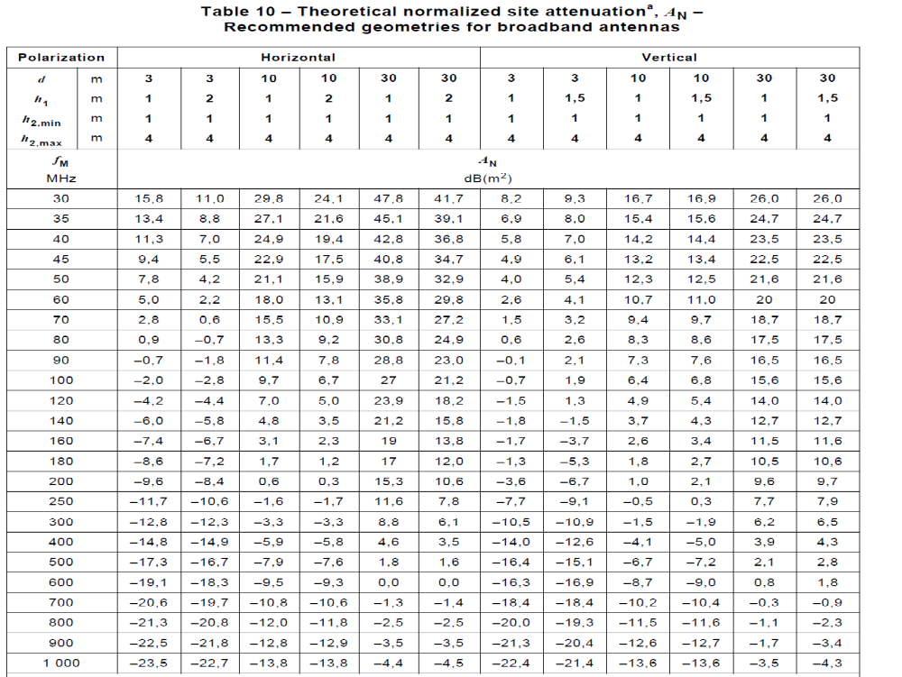
Theoretical Normalized Site Attenuation

Slide 30
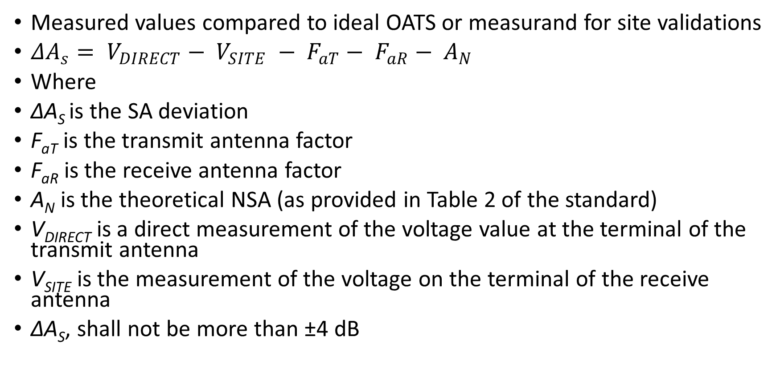
Site Attenuation SA Calculation
Measured values compared to ideal OATS or measurand for site validations
${ΔA}_{s}= V_{DIRECT}− V_{SITE} − F_{aT}− F_{aR}− A_{N}$
Where
ΔA_{S} is the SA deviation
F_{aT} is the transmit antenna factor
F_{aR} is the receive antenna factor
A_{N} is the theoretical NSA (as provided in Table 2 of the standard)
V_{DIRECT} is a direct measurement of the voltage value at the terminal of the transmit antenna
V_{SITE} is the measurement of the voltage on the terminal of the receive antenna
ΔA_{S}, shall not be more than ±4 dB

Slide 31
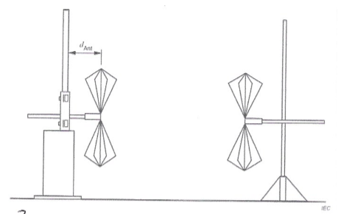
Example of co polarization

Slide 32
Validation of a weather-protection-enclosed OATS or a SAC
“Whenever construction material encloses a ground-plane test site, it is possible that the results of a validation measurement at a single location, as specified in paragraph 6.7, are not adequate to show acceptability of such an alternative site
Single measurement insufficient to pick up possible reflections from the material surrounding an OATS Turntable, (or walls and ceiling of a SAC)
Defines Test Volume – largest volume traced out by an EUT rotated 360 degrees
Up to 20 SA measurements taken

Slide 33
Volumetric measurement
20 measurement positions would include the center of the turntable, and the forward, left, right and rear edges of the turntable (5 transmit antenna locations total), with horizontal and vertical polarizations (2 polarizations total) and for 2 heights of the transmit antenna (1m and 1.5m for horizontal polarization, and 1m and 2m for vertical polarization).

Slide 34
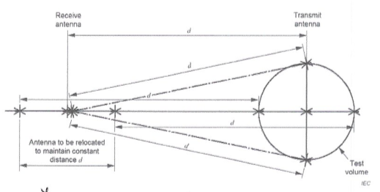
Vertical polarization measurement

Slide 35
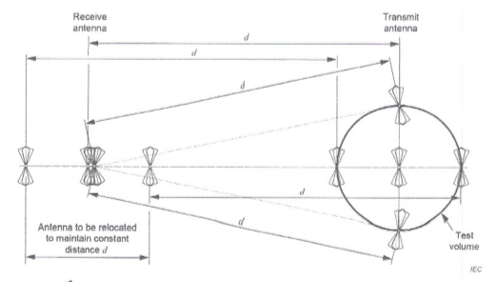
Horizontal Polarization measurements

Slide 36
Volumetric
Both Transmit and receive antennas moved to maintain test measurement distance
For SAC, Horizontal 25cm spacing should be between antenna tip and cone tip or 1m between antenna midpoint and closest absorber tip
FOR SAC, Vertical 25cm from lower tip of antenna to the floor, to prevent coupling with ground plane
Even if center of antenna is higher than 1m
For Weather enclosed sites, edge of turntable is usually selected as width of test volume, with 2m height

Slide 37
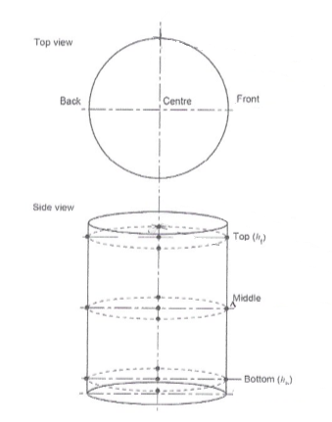
Example of test volume

Slide 38
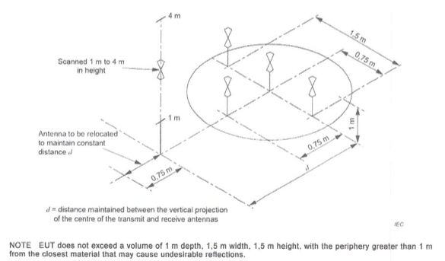
Exceptions

Slide 39
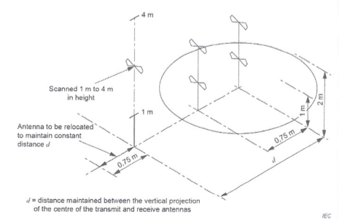
Exceptions

Slide 40
Possible causes for exceeding site acceptability limits
CISPR 16-1-4 recommends that the following items be rechecked if the site deviation, ΔA_{S}, exceeds the ± 4 dB requirement:
Measurement procedure
Antenna factor accuracy
Drift in the signal source
Accuracy of the receiver or spectrum analyzer input attenuator
Measurement device readings

Slide 41
Possible site faults causing failure
Annex F of the standard describes errors that can occur in NSA measurement. If no errors are found, it is likely that the site is at fault, and should be investigated. Key items recommended by the standard include:
ground plane construction inadequacies
Undesired reflections from the perimeter of the site or from an all-weather cover
Poor or no continuity between the turntable and the surrounding ground plane when the turntable is flush-mounted and conductive
Thickness of any dielectric ground plane covers
Openings in the ground plane, like trap door seams

Slide 42
2019 FAR Site Validation change
The new requirements for FAR site validation provides the addition of Table 2 that follows.
This table limits the size of the test volume diameter and height, depending on the test measurement distance.
This limitation did not exist in the previous standard publication, and we will delve into this further in future
presentations.
In the meantime, it is important to note that, if you wish, for example, to have a test volume greater than 1.5m in
diameter, then you must construct a 5m chamber, as a 3m chamber will not meet this criterion.
Again, this is only for FAR chambers and does not impact SAC and OATS requirements.
Maximum diameter, d_{max}, and height h_{max}, of the test volume m | Test distance d_{nominal} m
1.5 | 3.0
2.5 | 5.0
5.0 | 10.0

Slide 43
Questions??

